Slide 1
Summer 2020
ARIZONA@WORK Pinal County
Workforce Development Strategies for Businesses in High-growth Industries

Slide 2
A four part strategy is recommended
Candidate
Recruitment and
Screening
Talent
Development Pipelines
Community
Engagement
Public Relations
ARIZONA@WORK will work your company to develop, customize, and implement any or all of the recommended strategies

Slide 3
Candidate Recruitment and Screening
Create a process that identifies, attracts, screens, and selects the right candidates for your business
Information Required
Phased Hiring timeline
How many and by when?
Positions titles
Associated job descriptions & wages
Delineation of roles
Company HR & ARIZONA@WORK
Who does what?
Job information system used by Company
Can ARIZONA@WORK staff have access?
Processes to Develop
Applicant Screening Process
Questions, test, demo?
Marketing Campaign
How will these positions be advertised; Local, State, National?
Resources: Company, ARIZONA@WORK network, Arizona Commerce Authority, Pinal County PIO office, Statewide job database
Notes:
Recommend frontline workers

Slide 4
Proposed Candidate Recruitment and Screening Process
Job advertised
Candidates apply via Company job portal
ARIZONA@WORK reviews application and resume in Company job portal
Candidates who meet required qualifications are scheduled for a screening
ARIZONA@WORK conducts screening
Candidates who successfully screen are scheduled for an interview
Advertisement is shared throughout ARIZONA@WORK network, social media channels, etc.

Slide 5
Establish Talent Development Pipelines
Develop sustainable pipelines that leverage a variety of available programs and funding opportunities in order to develop a continuous supply of talent for your company
Tools that can be integrated into customized pipelines
Arizona Career Readiness Credential
Registered Apprenticeships
Automated Industrial Technology program graduates
On-the-job Training (OJT)
Work Experience
Incumbent Worker Training
Customized Training
Department of Defense SkillBridge
Alternative Talent Development
Internal Career Pathways
Resources: Company, ARIZONA@WORK network, Arizona Commerce Authority, Central Arizona College, Pinal County PIO office, Statewide job database

Slide 6
Arizona Career Readiness Credential
Validates employee work readiness in 7 foundational areas to include professional (soft) skills
Credential levels are aligned with Standard Occupation Classifications
Improves employee retention
No cost to participate

Slide 7
Company Career Career Pathways
What does career progression internal to your company look like?
Clearly defined career pathways can help an organization home grow its future leadership
Team Assembler
Facility Maintenance
Production Manager
Specified Performance & Tenure Met + Training
Specified Performance & Tenure Met + Training
Example
Notes:
Incumbent Worker Training could be used for this

Slide 8
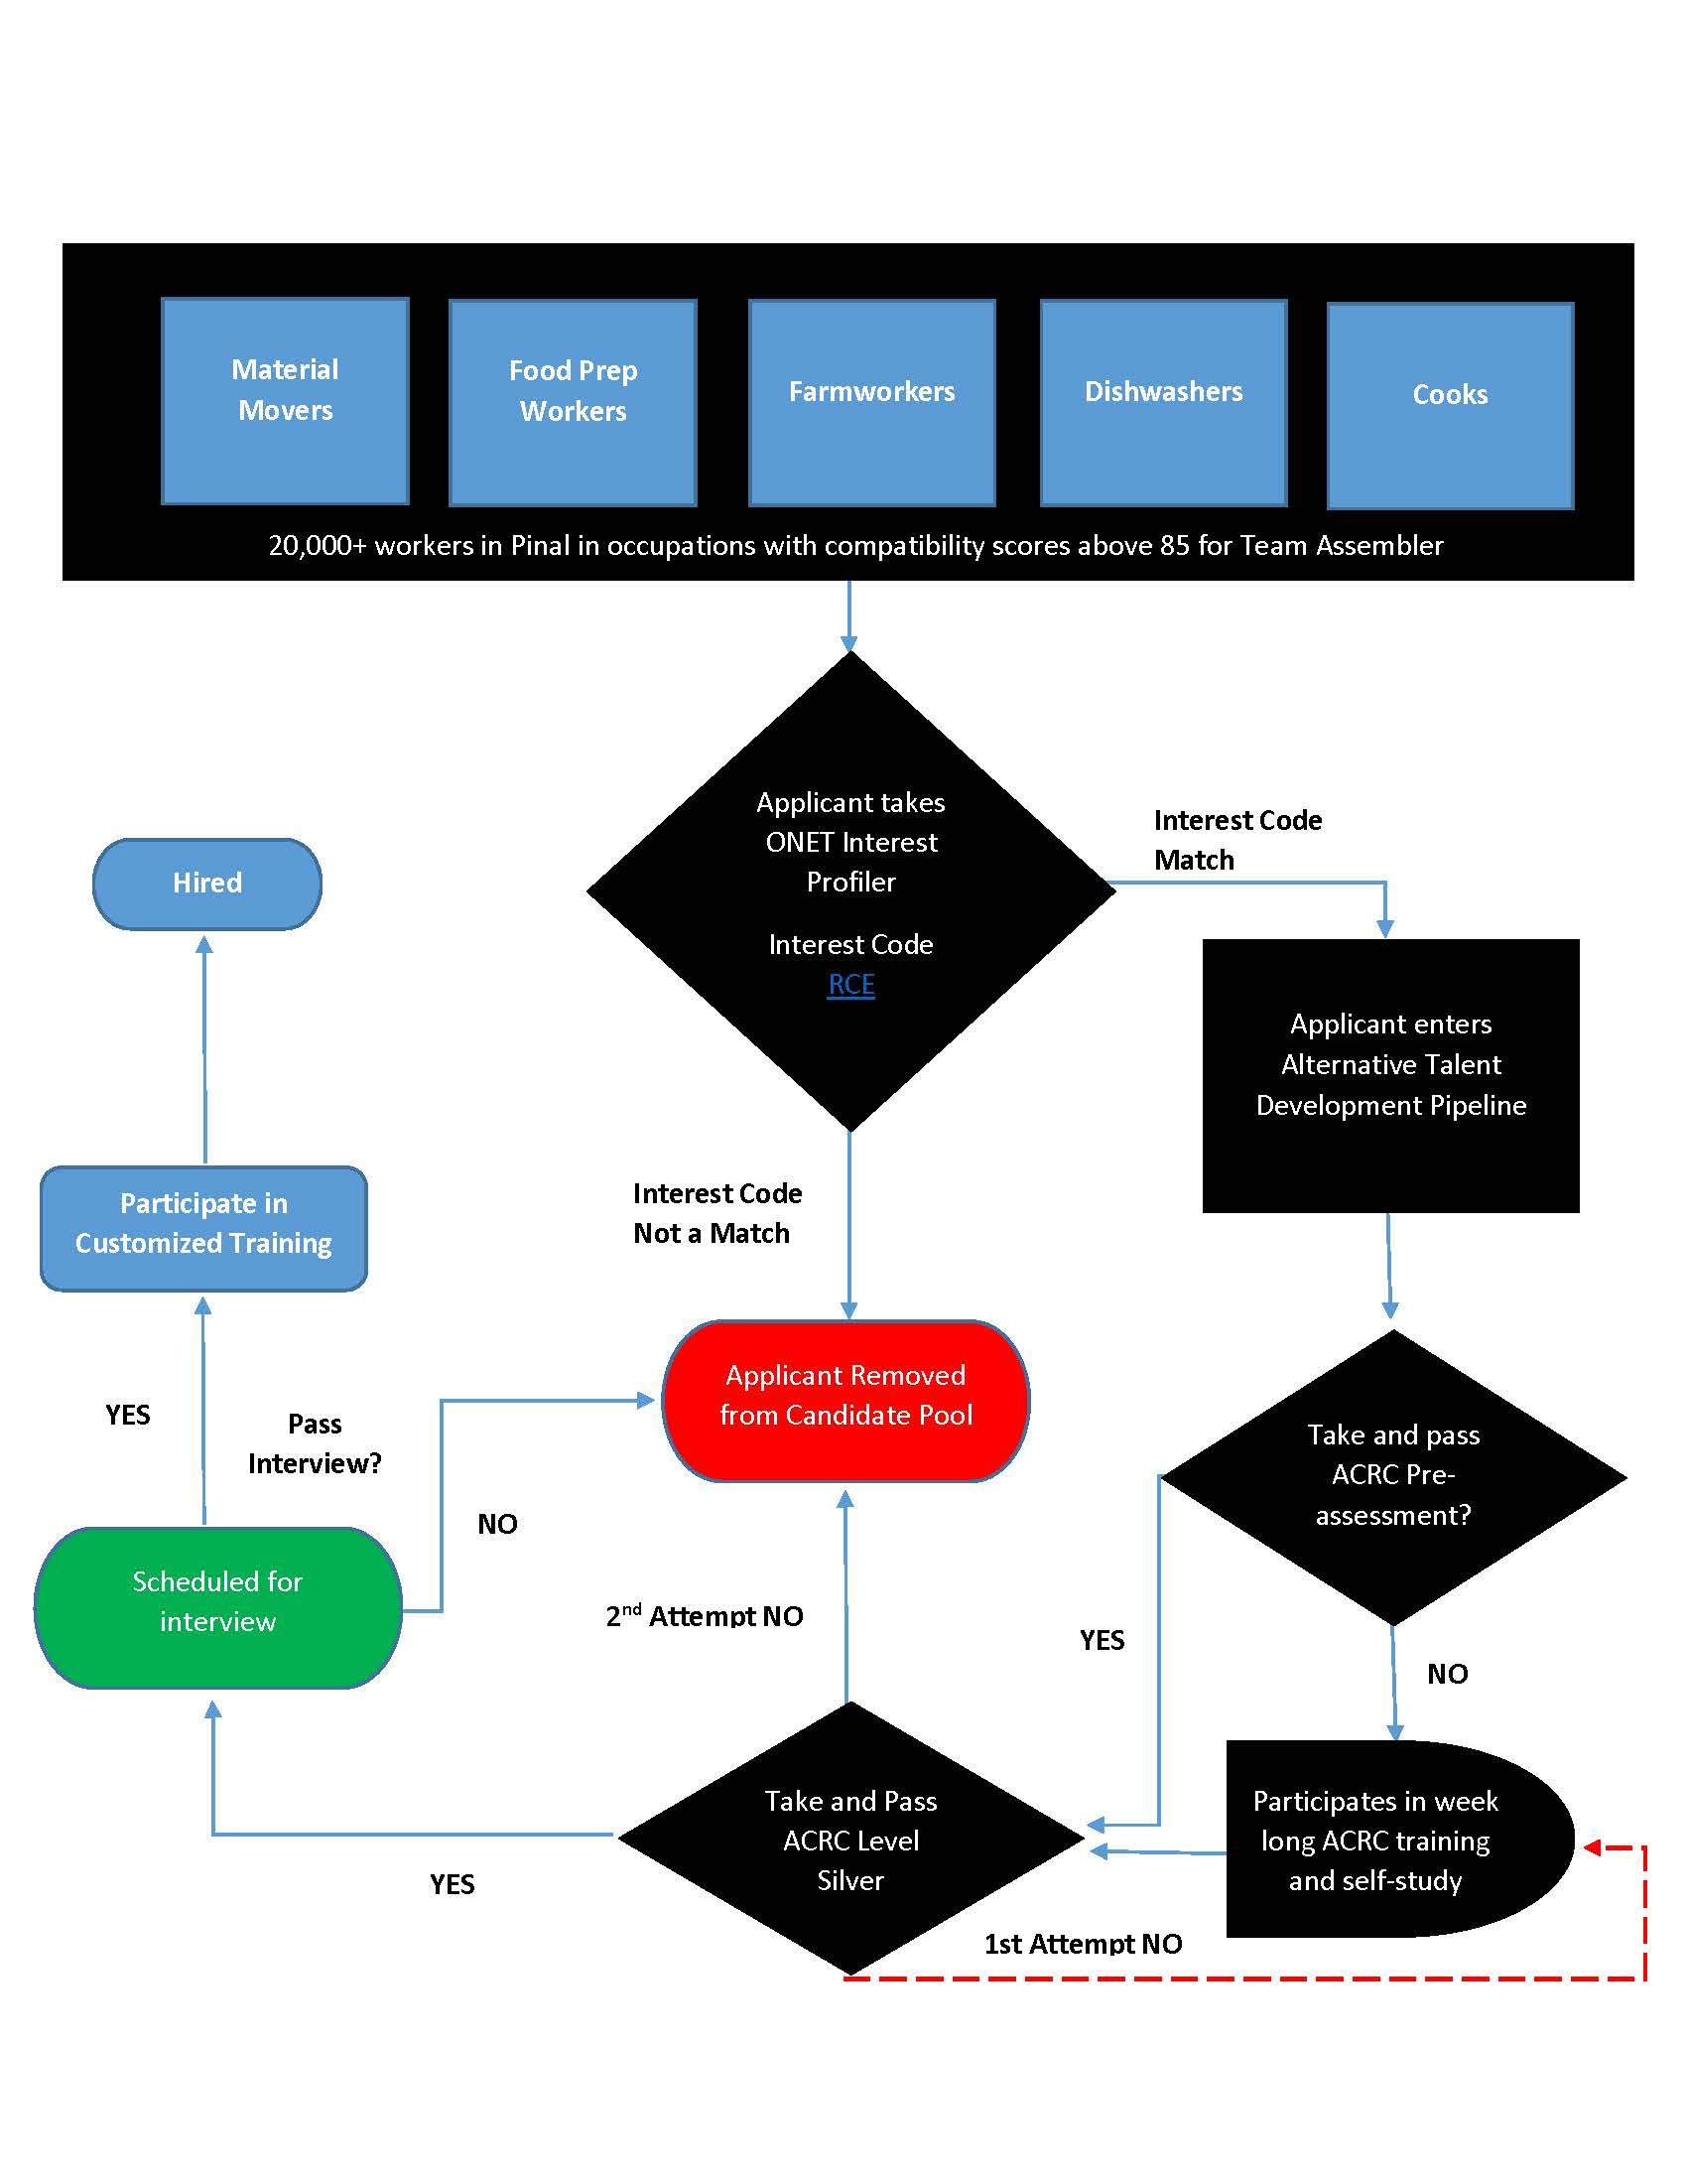
A Proposed Talent Development Pipeline
Develop frontline talent from occupations in other industries that require compatible skills
Identify Company’s frontline positions
Run Compatibility Index for each
Formulate a plan to engage regional workers and encourage participation in pipeline
Incorporate either Incumbent Worker Training (Post Hire) or Customized Training (Pre-Hire)
Incorporates ACRC and Customized Training
Notes:
Can use incumbent worker training to fund training related expenses for cohort of individuals after they have been working for six months or customized training as pre-hire training (must hire individuals who complete the training)
-Customized Training integration shown

Slide 9
Community Engagement Strategy
Participate in community initiatives that foster mutually rewarding relationships between Pinal County residents and your Company
Initiative will help shift the culture in the County
Quality jobs are here/coming
Opportunity to work closer to home
Initiative will create a “buzz” amongst future workforce
K-12 initiatives with Achieve Pinal
Presentations during AIT classes at CAC
Resources: Company, ARIZONA@WORK Pinal County, Central Arizona College, Pinal County PIO office, Achieve Pinal, Pinal Alliance Pinal County Workforce Development Board

Slide 10
Communication Strategy
Develop and implement a communication strategy that leverages web sites, social media platforms, newspapers, radio stations, etc.
Initiative will help tell the story, control the flow of information, and mitigate the impact of rumors
Establishes and maintains a synergy between your Company and Pinal County residents
Informs the community/region of upcoming hiring phases, plant progress, community activities, etc.
Clearly articulates the process required for getting hired with your Company (especially for positions that ARIZONA@WORK will potentially recruit, screen, and schedule interviews for)
Resources: Company, ARIZONA@WORK Network, Local Newspapers, ARIZONA@WORK website, Pinal County Public Information Office, Social Media channels

