Slide 1
Coconino County

Slide 2
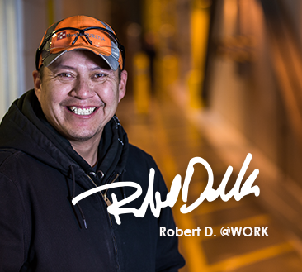
One Stop Overview
Welcome to The Coconino County
Comprehensive One-Stop overview
DES office
1701 N. 4th St.
Flagstaff, AZ 86004

Slide 3

Resource Room Expectations
Hours of Operations –
Monday – Thursday 8:00 am to 4:45 pm
Friday Virtual Services only
Sign in with a Workforce Specialist.
Job announcements posted.
Two-hour limit on the computers.
Children must be supervised by parents at all times.
Please put cell phone on vibrate.
No drinks or food allowed in Resource Room.
Please ask for assistance to use the scanner and fax machine.
Workforce Specialists are here to help you.

Slide 4

WORKSHOPS & EVENTS
Job Search Techniques Job Fairs (onsite)
Interviewing with Confidence Hiring Events
Resume Writing & Review Partner Information
Financial Literacy Workshop

Slide 5

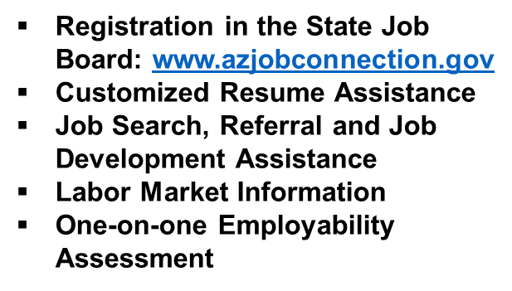
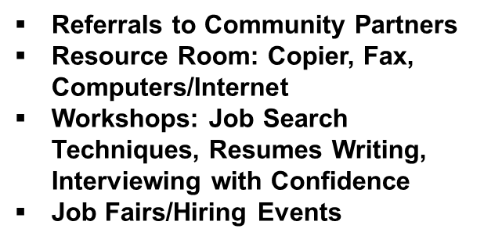

Department of Economic Security
Reemployment Assistance Administration
Employment Service provides services to help you become more employable and find work.
Anyone can utilize this service!

Slide 6
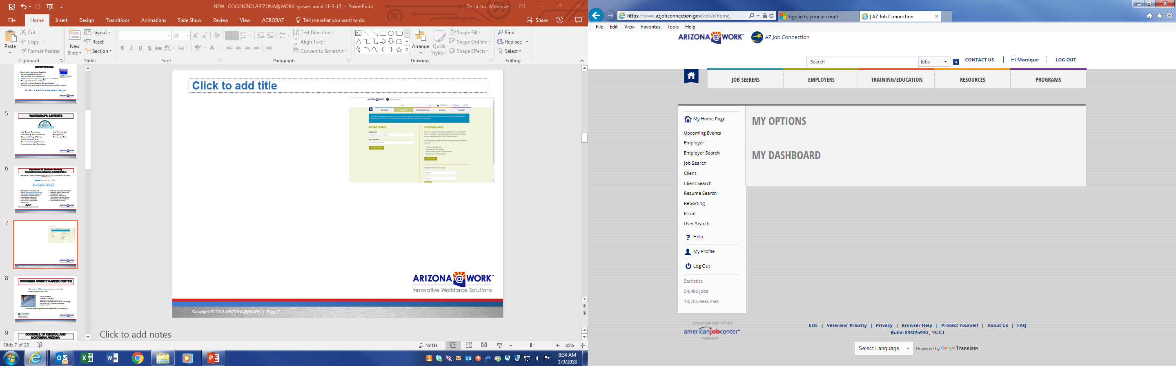
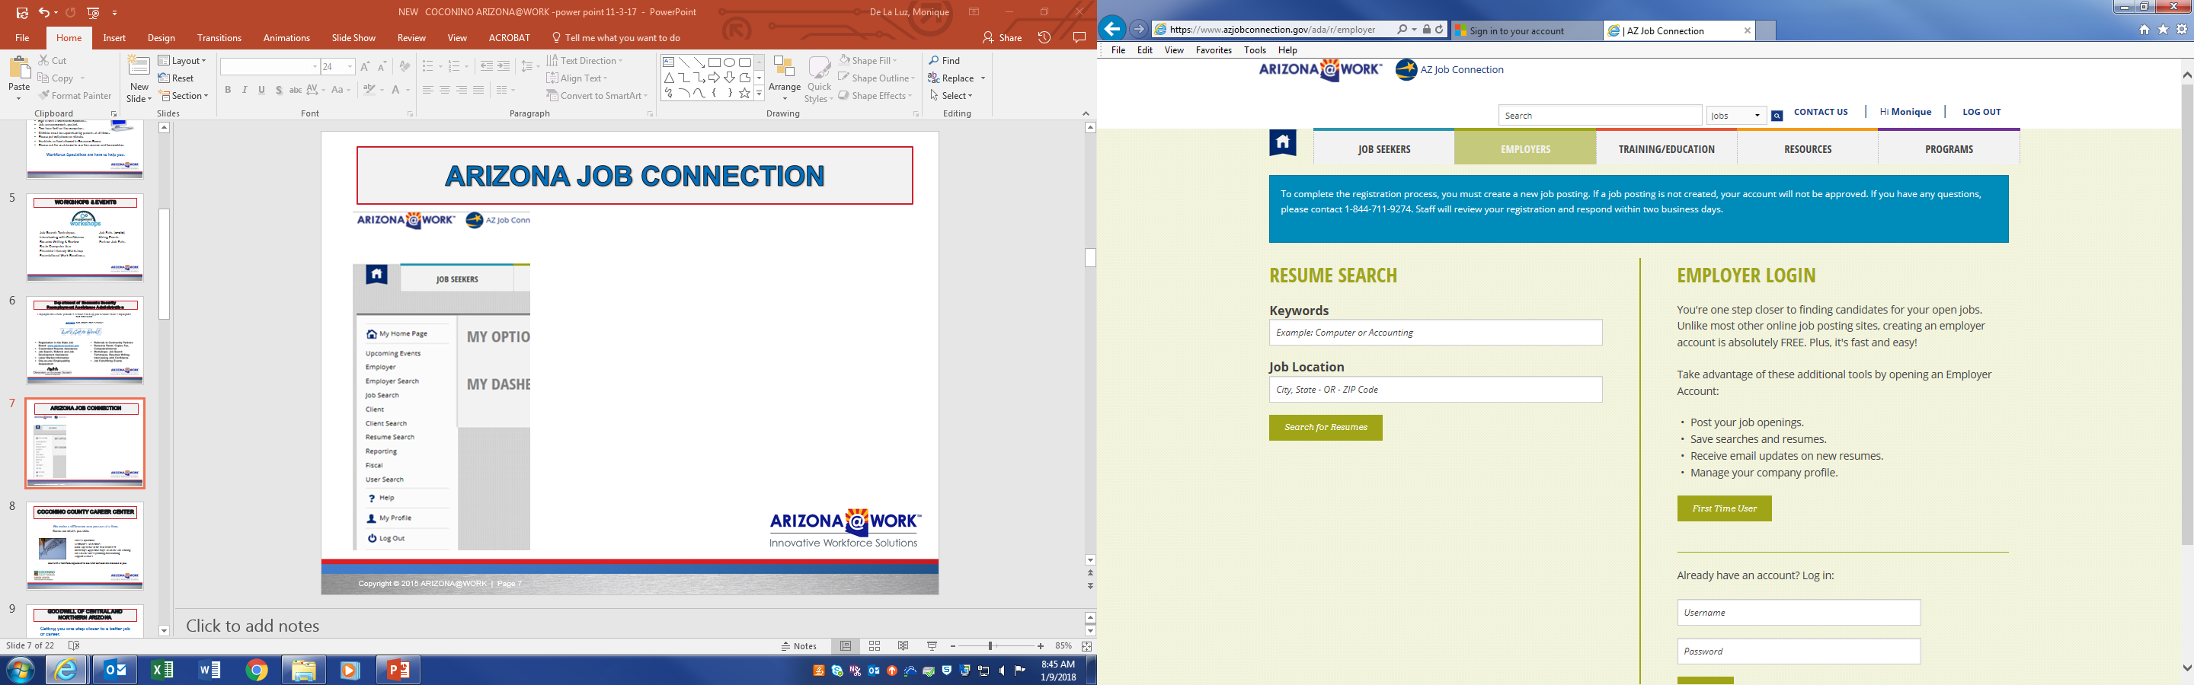
Arizona job connection

Slide 7


Coconino county career Services
We make a difference one person at a time.
Career Exploration
Certificates, Credentials
Work Experience in the field of interest
Internships, Apprenticeships, or On-the-Job Training
One On One career planning and coaching
Support Services
Meet with a Workforce Specialist to see what services are available to you.

Slide 8

Goodwill of Central and northern Arizona
  Getting you one step closer to a better job or career.
  Certificate Training
  Basic Computer Workshops
  Computer room available for job search, resume writing,
  Employment Information Center
  Assistance with Job Search with a Workforce Specialist
  Potential Employment at Goodwill

Slide 9

Native Workforce Services
Provides workforce opportunities to Native Americans, Alaskan Natives, or Native Hawaiians who reside in Coconino County, off- reservation areas. Funded by the Workforce Innovation and Opportunity Act.
Individuals need to attend orientation for eligibility requirements.
Work experience, internships, career advisement, career counseling,
Job search & referrals
Classroom training assistance, educational opportunities
Job search techniques, interview preparation, resume development
Supportive services.

Slide 10
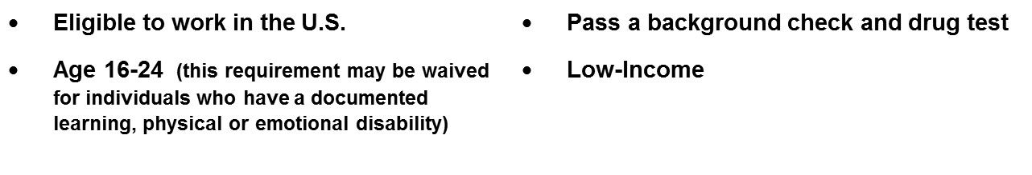
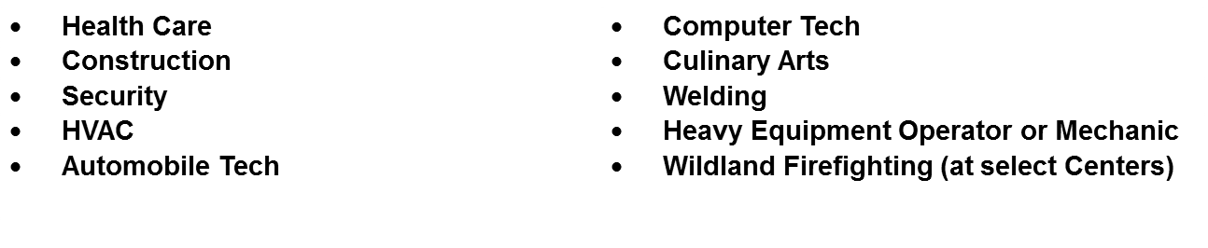

JOB CORPS
Job Corps is a FREE career training tuition, high school diploma or GED (as needed), transportation to a center, three meals a day, housing, uniform, recreational activities, driver’s training
Notes:
.

Slide 11

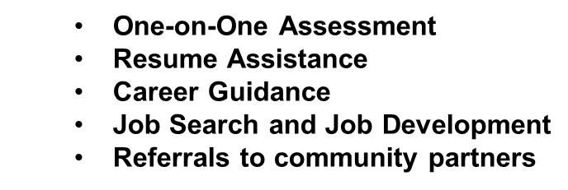
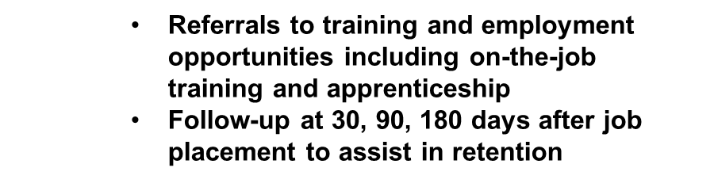

Employment Administration
Disabled Veterans Outreach Program (DVOP)
Disabled Veterans Outreach Program (DVOP) provides outreach, employment guidance and case management services to Veterans and eligible spouses of Veterans with significant barriers to employment.
  Veterans
  Disadvantaged Veterans
  Previously incarcerated offenders
  Homeless and other significant barriers to employment

Slide 12

Nation’s Finest
At Nation’s Finest, our mission is to support America’s military veterans and their families with a comprehensive approach to housing, health and employment that helps them achieve self-sufficiency and reach their full potential.
Assisting low-income veteran households who are either homeless or at-risk of becoming homeless.
Providing case management and temporary financial assistance to start housing for a household that lacks it or sustain housing for a household facing loss.
Notes:
WIOA Adult Priority of Service Criteria
There are three criterion that everyone has to meet for WIOA
The criteria that an adult must meet to be considered for priority of service
include low-income status or basic skills deficiency.
An adult is low-income when he or she is:
A
1. Currently receiving or has received public assistance in the
last six months, either solely or as a member of a family;
2. A member of a family whose total family income does not
exceed the higher of either the poverty line or 70 percent of
the Lower Living Standard (LLSIL);
3. A homeless individual, as defined in 42 U.S.C. 14043e-
2(6) of the Violence Against Women Act of 1994, or 42
U.S.C. 11434a(2) of the McKinney-Vento Homeless
Assistance Act; or
4. An individual with a disability whose own income meets the
income requirement in Section 104.02(A)(2), but is a
member of a family whose income does not meet this
requirement.
B. An adult is basic skills deficient when he or she is unable to:
1. Compute or solve problems; or
2. Read, write, or speak English at a level necessary to
function on the job, in his or her family, or in society.

Slide 13

CATHOLIC CHARITIES
Supportive Services for Veterans Families Grant (SSVF)
Assists Veterans and their families experiencing homelessness or risk of homelessness with case management
Case by case basis are able to allocate rental assistance
Temporary Financial Assistance for Veterans and their families.
Financial Coaching/Mentoring Workshops
Other services offered
Notes:
Eligibility of a dislocated worker is determined at the time of enrollment.
A dislocated worker is an eligible adult (see Section 103.01) who meets
one of the following four categories.
B. Category II includes an individual who:
1. Has been terminated or laid off, or has received a notice of
termination or layoff from employment as a result of any
permanent closure of, or any substantial layoff at, a plant,
facility, or enterprise; or
D. Category IV includes an individual who:
1. Is a displaced homemaker (an individual who has been
providing unpaid services to family members in the home);
2. Is the spouse of a member of the Armed Forces on active
duty, as defined in U.S.C. Title 10 Section 101 (d) (1), and
who has experienced a loss of employment as a direct result
of relocation to accommodate a permanent change in duty
station of such member; or
3. Is the spouse of a member of the Armed Forces on active
duty, or who has been discharged from the military, and is
unemployed or underemployed and is experiencing difficulty
in obtaining or upgrading employment.

Slide 14

Coconino County Community Services
Community Services provides assistance to residents of all ages!
Offices located in Flagstaff, Williams, Page, Fredonia
Assisting residents with move-in, rental payment, utility assistance
Financial Literacy Workshops
Senior Utility Assistance Program
Senior Services, Meals on Wheels, Employment & Volunteer Opportunities
Eligibility Requirements

Slide 15

Housing Solutions & Sharon Manor
Housing Solution of Northern Arizona is a non-profit organization focused on programs for local residents to identify & maintain affordable housing.
Programs & Services include:
Sharon Manor
Homebuyer Assistance
Foreclosure Prevention
Credit Counseling
Affordable Rentals

Slide 16
Rehabilitation Services Administration
The Vocational Rehabilitation (VR) provides a variety of services to individuals with disabilities, with the ultimate goal to prepare for, enter into, or retain employment.
Based on eligibility, an individual’s needs, the following types of services may be available:
Vocational guidance and counseling
Training
Work-site evaluations
Job development & Job placement services
Rehabilitation technology services and assistive devices
Other support services
Notes:
The expansion of DW funding to Spouses.

Slide 17

Senior Community Service Employment Program
SCSEP is a work-based job training program for older Americans.
Some employment areas may include public facilities, including schools, hospitals, day-care centers, and senior centers.
Must be 55 years of age or older
Must be unemployed
Low Income Program
Paid on-the-job training
Enrollment priority is given to veterans and qualified spouses

Slide 18


Arizona Department of Education
Coconino Community College Adult Education
Do you want to get your GED or learn English but need some help?
GED Preparation Classes in Flagstaff, Page and Tuba City
English Language Classes in Flagstaff
Distance Leaning (online) Options Available
Transitions to College and Careers

Slide 19

EDUCATIONAL OPPORTUNITY CENTERS
A FREE educational service to adults seeking higher education.
GED/Information on postsecondary schools
Admission information/assistance
Scholarship application assistance
Financial Aid /FAFSA assistance
Career exploration

Slide 20

America’s SBDC Arizona
Small Business Development Center
Do you have an idea of starting a business or growing an existing one?
Visit SBDC calendar of events to keep you updated on what is happening at the SBDC.
Basic Business Empowerment Course
Counseling
Start Up Resources
Business Resources

Slide 21
Resources
Job Seeker
Veteran Priority of Service
Access to Computers, Printers, Internet, and Phone
Access to the Statewide Job Database (azjobconnection.gov)
Career Coaching
Educational Programs
Employment Services for Persons with Disabilities
Financial Literacy & Mentoring
Job Leads, referrals to employers
Link to Community Resources
Migrant Seasonal Farmworker Resources
Vocational Training & Career Services

Slide 22

Thank you for participating
Creating an Arizona Job Connection account
Posting your resume on the statewide job database
Providing career guidance and assessment
Matching you with job opportunities
Offering customized training, education and skills development
Hosting hiring events, connecting you with employers
Connecting you with community partners
https://www.azjobconnection.gov/ada/r/

Slide 23


Thank you for attending today!

