Slide 1
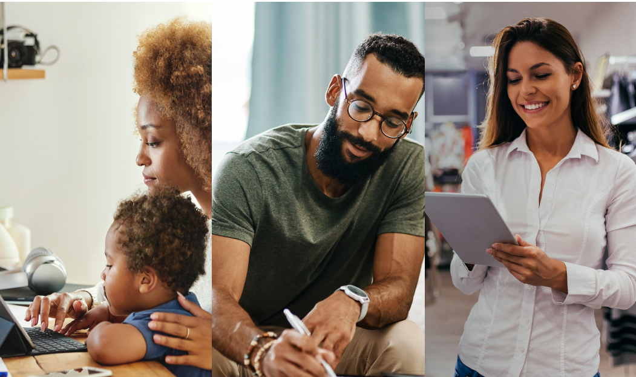
Strategic Communication & Partnership Committee
Presented by
October 2022 (Q4)

Slide 2
Policy Development
Branding Policy

Slide 3
Brand Policy
A comprehensive, unified and aligned system of world-class services for job seekers, workers, employers and businesses is communicated through the ARIZONA@WORK brand.
The policy strengthens the identity of Arizona’s workforce development system and eliminates the potential for market confusion.
Through a unified brand identity, Arizona’s workforce development system has greater statewide influence.

Slide 4
Brand Policy – Status Update
DRAFT of Brand Policy has been completed
Includes research of policies from more than 20 states
Currently under review with internal stakeholders
Plan to post for public comments late October/early November.
Brand policy refers to the Brand Style Guide

Slide 5
Brand Style Guide
Last updated in 2021
Includes:
Logo design
Color Palette
Fonts and Formatting
Usage examples
Updating to 2022 version

Slide 6
Style Guide
Note: Logos are from 2021 Brand Style Guide.

Slide 7
ARIZONA@WORK Brand Policy
Used to represent the entire state’s workforce system.
Used to represent local the workforce development areas.
Can be used by required American Job Center one-stop network partners in Arizona.

Slide 8
Recommendations
Approve Brand Policy to distribute for comment
Make change to page 3 of style guide
Re-define “Partner Logo” to include only required AJC partners
Add a “Community Supporter Logo” to include other organizations that support the Arizona Workforce System
sample:
A proud supporter of Arizona’s Workforce System

Slide 9
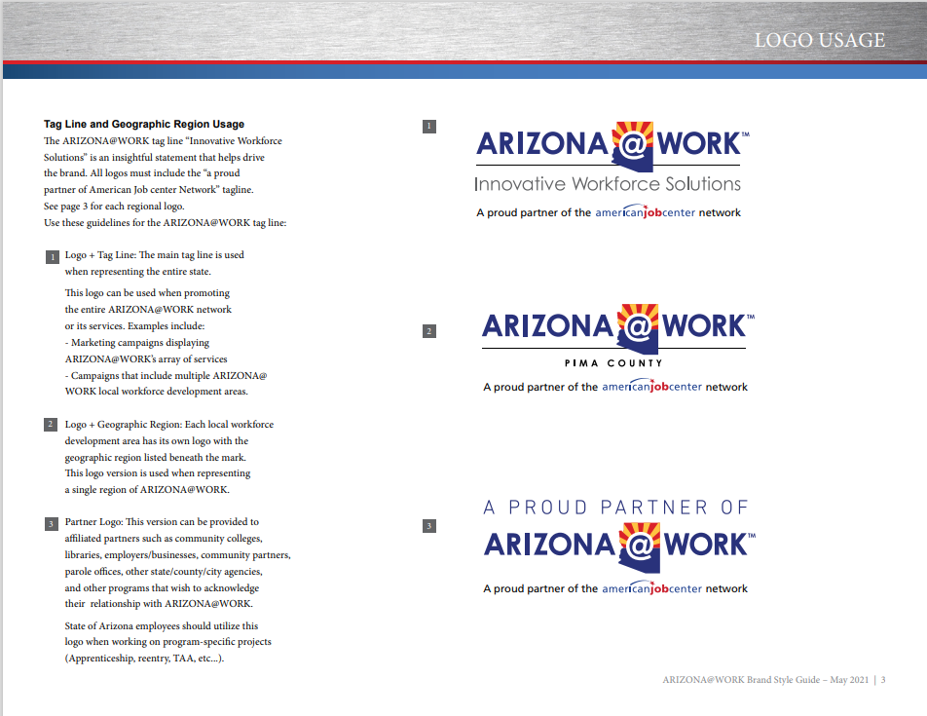
Reference:

Slide 10
Questions, comments, or suggestions from the Committee?

Slide 11
Council Policies
Revisions and Timeline

Slide 12
POLICY | ISSUE DATE | DESCRIPTION
Conflict of Interest | February 28, 2019 | Guidance on conflict of interest, firewalls and internal controls
ARIZONA@WORK Job Center MOU and Infrastructure Costs | August 24, 2017 | Instruction and guidance regarding the administration of ARIZONA@WORKS Job Center Delivery system.
This is actually a template – ARIZONA@WORK Job Center Assessment Tool (Part ll -Alignment with Workforce Arizona Council Vision | August 24, 2017 | A template that is utilized AJC Certification
This is actually a template – ARIZONA@WORKS Job Center -Part 1 – Compliance with WIOA Regulations Certification Assessment Tool for Affiliate and Specialized Sites | November 11, 2019 | Affiliate and Specialized Site template for certification process
ARIZONA@WORKS Job Center Vision for One Stop Delivery System #2 | January 16, 2017 | Guidance regarding the administration of ARIZONA@WORKS Job Center Service Delivery system.
ARIZONA@WORK Job Center Structure of One Stop Delivery System #3 | February 16, 2017 | Guidance regarding the administration of ARIZONA@WORKS Job Center Service Delivery system.
ARIZONA@WORK One Stop Operator and Service Provider Selection Policy | June 5, 2019 | Defines roles and responsibilities of the One-Stop- Operator, ADW, and Youth Career Services providers and the selection processes.
Certification of ARIZONA@WORKS Job Center Policy | August 24, 2017 | Statewide criteria and procedures for use by LWDB to certify the ARIZONA@WORKS Job Centers.
ARIZONA@WORKS WIOA Statewide Monitoring Policy | November 30, 2017 | Roles of WAC, and DOE, and DES role in WIOA as defined in State Plan. Provide monitoring information, define statutory and strategic objectives.
WAC Bylaws | August 18, 2016 | Roles, and responsibilities, and structure of WAC.

Slide 13
Policy Revision Plan
Continue work with Ken Mall- EDSI
Create a plan
1st Quarter
Complete project by March 2023
Establish workgroup
Workforce Staff
Council and Committee members
Partner with DES Policy Administration and Program staff

Slide 14
Annual Convening
Planning and Discussion

Slide 15
Annual Council Convening - Planning
Date - December 8, 2022
Location - West Mec, Southwest Campus (Buckeye, AZ)
In-person only (10:00 am - 3:00 pm)
Registration online (https://olegshvets9.wixsite.com/2022convening)
Programing Considerations
Keynote Speaker - Brian Wright, City of Buckeye Economic Development Manager
Workshops and Breakout Sessions
Morning Session Combined with CTE
Afternoon break-outs (WF - “Broadband Workforce Initiative” & “Apprenticeships, start - finish”) (CTE - “ACRC” and “AZ Future Economy”)

Slide 16
Council Annual Report
Plan and Timeline

Slide 17
Annual Report Progress Update
Background
Performance of Title Programs and Community College Districts
Due December 1st (AZ Legislature and Governor’s Office)
MARCOM edits and 1st draft for review - November 9th
Final edits- November 10th-15th
Send to print- November 16th
Final Delivery- November 29th

Slide 18
Council Restructure
Committee Discussion

Slide 19
Proposed Council Structure Changes
National Governors Association
Best Practices
Challenges
Committees vs. Workgroups
Beginning 1st Quarter 2023
Effectiveness and Efficiency
Statewide Collaboration
Strategic Plan
Initiatives and Priorities
Compliance vs. Statewide Expectations and Impact

Slide 20
Draft Structure
***Additional Workgroups may be created as needed
Workforce Arizona Council
Implementation of Robust and Effective Workforce System
Executive Committee
Policy
WIOA Reauthorization
Compliance Approvals
Business
Education
Priority Populations
Work Based Learning
Broadband
Apprenticeships
CTE
STEM
Career Pathways
Apprenticeships
Youth
Digital Equity
Integrated Service Delivery
Research and Evaluation

Slide 21
Questions
&
Comments

