Slide 1
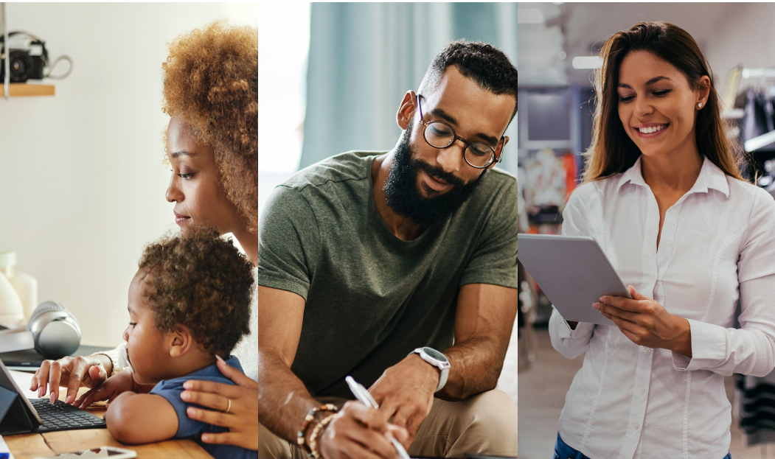
Executive Committee
November 2022

Slide 2
Workforce Team Updates
Office of Economic Opportunity

Slide 3
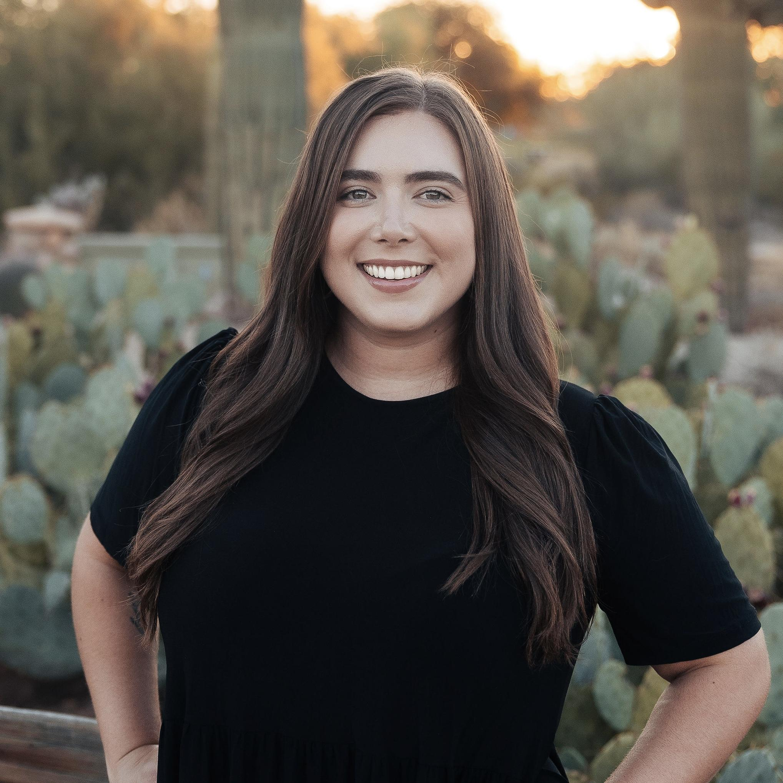
Welcome
Kennedy Riley
Performance Manager
kennedy.riley@oeo.az.gov
Responsibilities & Projects:
Updating Council policies, procedures, bylaws and research of best practices
Preparing the annual report
Tracking performance across the state and identifying areas of improvement
Coordinating with various state agencies on a variety of projects and performance measures

Slide 4
Council Policies
Revisions and Timeline

Slide 5
POLICY | ISSUE DATE | DESCRIPTION
Conflict of Interest | February 28, 2019 | Guidance on conflict of interest, firewalls and internal controls
ARIZONA@WORK Job Center MOU and Infrastructure Costs | August 24, 2017 | Instruction and guidance regarding the administration of ARIZONA@WORKS Job Center Delivery system.
This is actually a template – ARIZONA@WORK Job Center Assessment Tool (Part ll -Alignment with Workforce Arizona Council Vision | August 24, 2017 | A template that is utilized AJC Certification
This is actually a template – ARIZONA@WORKS Job Center -Part 1 – Compliance with WIOA Regulations Certification Assessment Tool for Affiliate and Specialized Sites | November 11, 2019 | Affiliate and Specialized Site template for certification process
ARIZONA@WORKS Job Center Vision for One Stop Delivery System #2 | January 16, 2017 | Guidance regarding the administration of ARIZONA@WORKS Job Center Service Delivery system.
ARIZONA@WORK Job Center Structure of One Stop Delivery System #3 | February 16, 2017 | Guidance regarding the administration of ARIZONA@WORKS Job Center Service Delivery system.
ARIZONA@WORK One Stop Operator and Service Provider Selection Policy | June 5, 2019 | Defines roles and responsibilities of the One-Stop- Operator, ADW, and Youth Career Services providers and the selection processes.
Certification of ARIZONA@WORKS Job Center Policy | August 24, 2017 | Statewide criteria and procedures for use by LWDB to certify the ARIZONA@WORKS Job Centers.
ARIZONA@WORKS WIOA Statewide Monitoring Policy | November 30, 2017 | Roles of WAC, and DOE, and DES role in WIOA as defined in State Plan. Provide monitoring information, define statutory and strategic objectives.
WAC Bylaws | August 18, 2016 | Roles, and responsibilities, and structure of WAC.

Slide 6
Policy Revision Plan
Continue work with Ken Mall- EDSI
Create a plan
1st Quarter
Complete project by March 2023
Establish workgroup
Workforce Staff
Council and Committee members
Partner with DES Policy Administration and Program staff

Slide 7
Council Annual Report
Plan and Timeline

Slide 8
Annual Report Progress Update
Background
Performance of Title Programs and Community College Districts
Due December 1st (AZ Legislature and Governor’s Office)
MARCOM edits and 1st draft for review - November 9th
Final edits- November 10th-15th
Send to print- November 16th
Final Delivery- November 29th

Slide 9
AZ Quest Grant
Award and Overview

Slide 10
DOL National Dislocated Worker Grant
Arizona QUEST $15 million award
6 Local Workforce Development Areas
Cochise, Maricopa (City of Phoenix), Mohave/La Paz, Pima, Yavapai, and Yuma
1500 participants- Dislocated workers impacted by COVID-19
Industries
Healthcare, Manufacturing, Logistics, and Professional, Scientific and Technical Services
Grant focus
Partnerships and Outreach
Business Engagement
Employment and Training

Slide 11
Local Plan Modifications
2020 - 2024

Slide 12
Local Plan Modification Update
Final Drafts Received
City of Phoenix
Maricopa County
Mohave / La Paz
Pima County
Santa Cruz County
Southeastern Arizona
Yuma County
Final Draft pending CEO approval
Coconino County
Remaining Local Areas
Nineteen Tribal Nations
Northeastern Arizona
Action Item: Vote to approve completed Local Plan Modifications, conditionally approve the Local Plan Modification pending CEO approval, send formal letter to NEAZ and move to Full Council.
Notes:
Coconino- December 6th
NEAZ- send formal letter with 12/31 deadline. Plan must be completed and submitted by end of December or the Council/DES will move forward with corrective action which could result in a substantial violation. DES will be available to provide any TA.
Based on ongoing compliance issues and status of NTNs Fiscal Agent, DES will continue to work with bringing their LWDB compliant

Slide 13
Local Workforce Development Board
Nineteen Tribal Nations Update

Slide 14
NTN Update - Fiscal Agent Designation
In 2019, the NTN LWDB was the designated Fiscal Agent
Funds were distributed to each of the 13 Tribes
DOL found the lack of a single entity to function as the Fiscal Agent non-compliant:
Conflict of interest
No oversight to ensure compliance
DES instructed NTN to designate one entity as the Fiscal Agent

Slide 15
NTN Update - Fiscal Agent Designation
Since 2019, DES has worked with NTN to designate one entity to serve as the Fiscal Agent
Pascua Yaqui Tribe was approved in 2020, but never fully assumed responsibility and notified NTN in May 2022 that the tribe could not serve as the Fiscal Agent
DES and NTN approached 3 non-profit organizations – Local First Arizona, Inter Tribal Council of Arizona, and the Phoenix Indian Center – all declined

Slide 16
NTN Update - Fiscal Agent Designation
What’s Next?
DES to assist NTN identify a Fiscal Agent by conducting a “Request for Information” (RFI)
RFI will be sent to potential interested parties to ascertain interest from viable organizations who could serve as the Fiscal Agent to the NTN
If only 1-3 viable organizations respond with interest, NTN may engage in negotiations with the interested organizations
If more than 3 viable organizations respond with interest, DES will conduct a competitive procurement to assist the NTN in identifying an entity to serve as the Fiscal Agent

Slide 17
NTN Update - Fiscal Agent Designation
Temporary Measures:
DES issued separate grant agreements for PY21 adult and youth funding to the 13 tribal nations to continue services
The Salt River Pima-Maricopa Indian Community agreed to receive the NTN Board funds through Sept. 2022
Funds used to pay the Executive Director and 3 Staff
The Gila River Tribe agreed to receive the funds for November through April 2023

Slide 18
NTN Update - Fiscal Agent Designation
DES issued correspondence to update the following individuals:
Kristine Firethunder, Director, Governor’s Office of Tribal Relations
Cindy Ptak, Governor's Office, Program Manager, Arizona Infrastructure and Jobs Act Task Force
The Tribal Leaders of the 13 NTN Tribes

Slide 19
Committee Reports
Strategic Communications & Partnerships Committee

Slide 20
Strategic Communications and Partnership Committee
ARIZONA@WORK Brand Policy
DRAFT of Brand Policy has been completed
Includes research of policies from more than 20 states
Currently under review with internal stakeholders
Plan to post for public comments late October/early November.
Brand policy refers to the Brand Style Guide
Annual Council Convening
December 8th, 2022
West Mec SW Campus, Buckeye 10am-3pm
Focus on Broadband, Apprenticeships and CTE Programming

Slide 21
Committee Reports
Performance and Accountability Committee

Slide 22
Performance and Accountability Committee
Employer Measures
Notice of Proposed Rulemaking (NPRM)
Proposal to revise the text of the WIOA regulations to use Retention with the Same Employer as the performance indicator used to define effectiveness in serving employers for all six WIOA core programs.
The data for all six core programs will be combined into one measure
Provided the rationale used by DOL and DOE for choosing the one approach over the others two and their plans for implementation
DES submitted comment on November 14, 2022
Yuma County Waiver
Business vacancy waiver request
WIOA Local Governance Policy
Must be filled within 120 days
Extension request sent October 6th, 2022
Seeking waiver through December 31, 2022
Action Item: Vote to approve the waiver request through December 31st, 2022

Slide 23
Committee Reports
Quality Workforce

Slide 24
Quality Workforce Committee
Approve meeting minutes- August 2nd Committee Meeting
ACRC
RFP issued, closed Nov. 4th for 5-year continuation of full program
process to be finalized by Jan. 2023
Digital Literacy is trending
Professional Skills Certificate is on the rise
Apprenticeships
Final Rule to Rescind the Industry Recognized Apprenticeship Program
Effective November 25, 2022
Direct all resources back to Registered Apprenticeships
Good Paying Jobs
Create reliable pathways
Arizona Education Job Fair and Career Expo
February 4th, 2023 8am-2pm
Resume and Interview Workshops

Slide 25
Workforce Arizona Council
Restructure and Vote

Slide 26
Proposed Council Structure Changes
National Governors Association
Best Practices
Challenges
Committees vs. Workgroups
Beginning 1st Quarter 2023
Effectiveness and Efficiency
Statewide Collaboration
Strategic Plan
Initiatives and Priorities
Compliance vs. Statewide Expectations and Impact

Slide 27
Draft Structure
***Additional Workgroups may be created as needed
Workforce Arizona Council
Implementation of Robust and Effective Workforce System
Executive Committee
Policy
WIOA Reauthorization
Compliance Approvals
Business
Education
Priority Populations
CTE
STEM
Career Pathways
Apprenticeships
Work Based Learning
Broadband
Apprenticeships
Youth
Digital Equity
Integrated Service Delivery
Research and Evaluation

Slide 28
Council Priorities- 2023 Strategic Plan
Broadband
Surface Transportation Construction
Electric Vehicle Charging Infrastructure
Digital Equity
Apprenticeship
Healthcare Pipeline
Work Based Learning
Integrated Service Delivery
Continuous Improvement
Youth Services
CTE
STEM
K-12 Education
Semiconductor and Advanced Manufacturing
Rural/Tribal Workforce Development
WIOA Reauthorization
Research and Evaluation- WIOA
Action Item: Vote to approve the Workforce Arizona Council restructure, dissolving Committees and creating OEO staff led workgroups and move to Full Council.

Slide 29
Workforce Arizona Council Agenda
Council Agenda

Slide 30
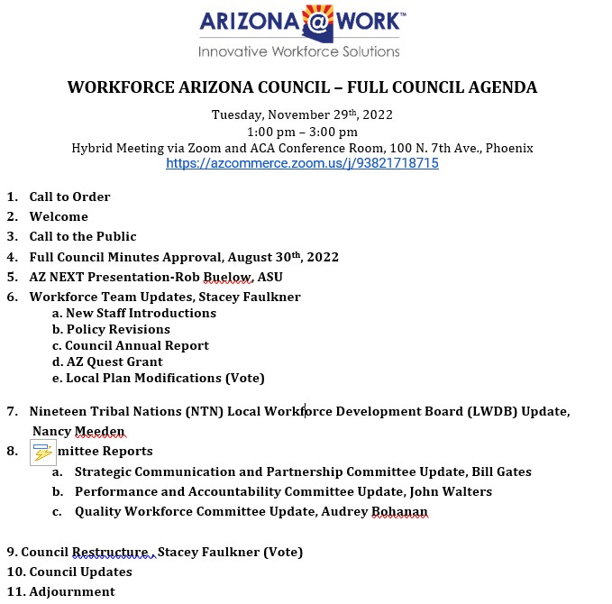

Slide 31
Questions
&
Comments

