Slide 1
Workforce Arizona Council
Full Council Meeting
9/7/2023

Slide 2
OPENING REMARKS
Welcome Governor Hobbs

Slide 3
CELEBRATE PHOENIX ELECTRICAL
Chairman Mark Gaspers

Slide 4
Phoenix Electrical Celebrates 80th Anniversary!
- Founded on September 3, 1943, by International Brotherhood of Electrical Workers, Local Union 640, and Arizona Chapter of National Electrical Contractors Association.
- Distinctive approach: Classroom instruction + practical experience guided by experienced workers.
- Adapted to industry changes: Integrated modern tech, renewable energy education. Prioritized inclusivity, community engagement for diverse, skilled workforce.
- Over 800 apprentices today, the cornerstone of electrical education.
- 80-year legacy showcases dedication to progress, industry standards..
- Proudly celebrating 80 years of shaping skilled electricians and propelling our community forward.

Slide 5
WORKFORCE ADMINISTRATOR REPORT OUT
Stacey Faulkner, OEO

Slide 6
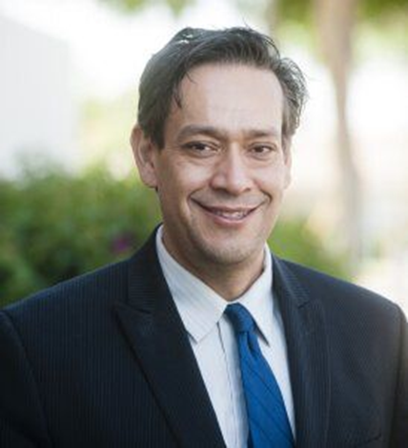
Welcome Director Contreras
Third-generation engineer, graduated from University of Arizona and Thunderbird (Finance)
30 years of industry experience primarily within Intel Corporation
His career journey has encompassed diverse roles in engineering, finance, education, public affairs, and emerging technology policy
Hobbies: Woodworking, welding, 66 mustang mechanic (ok), retiring (not good)

Slide 7
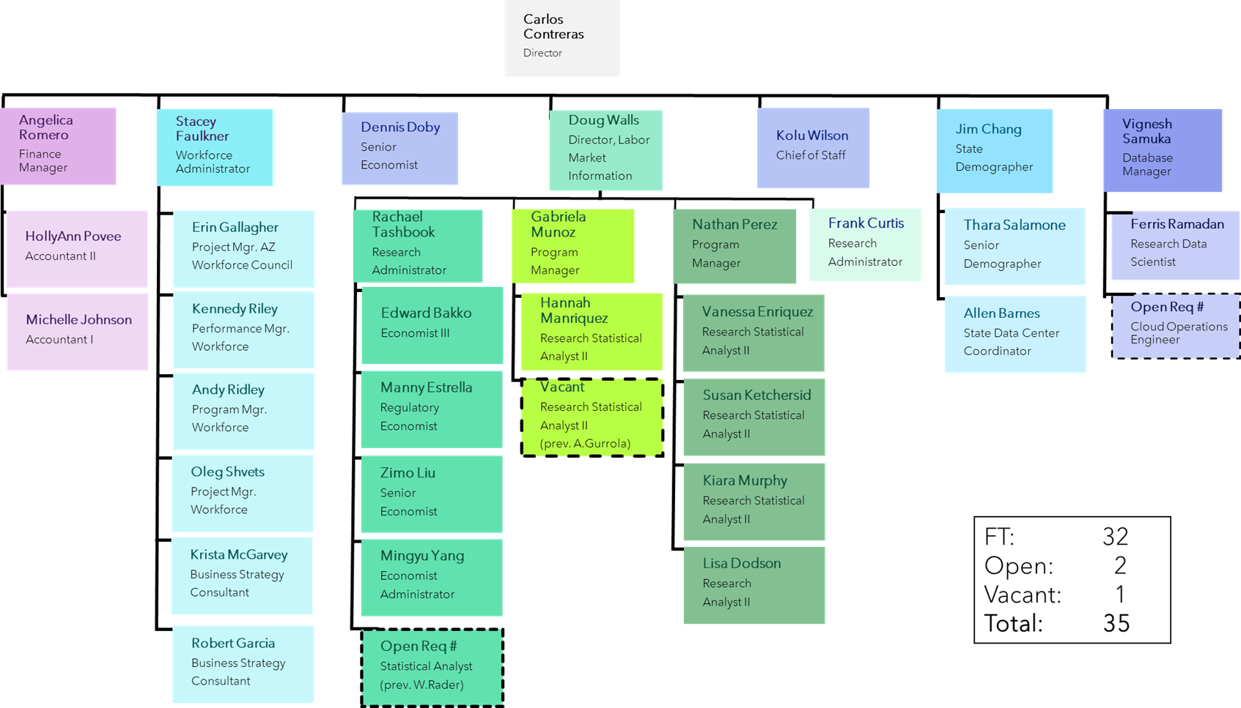
Notes:
OEO Updates- org chart here

Slide 8
Workforce Administrator Report Out
NGA Conference
Chairman Mark Gaspers- Appointed to Chairs Executive Committee
WIOA State Planning
Apprenticeships
Youth Employment and Career Prep
DOL Vision 2030 Meeting
The Reemployment Services and Eligibility Assessments (RESEA)
Apprenticeships
Infrastructure
Sector Strategies- High Quality Jobs
* Council priorities identified in Strategic Plan

Slide 9
Maui Assistance: How Can We Help?
Maui United Way: Fire Disaster Relief
https://mauiunitedway.org/
Council for Native Hawaiian Advancement: Kākoʻo Maui Fund
https://hawaiiancouncil.org/helpmaui
Maui Strong Fund: Focus on rapid response and recovery.
https://www.hawaiicommunityfoundation.org/strengthening/maui-strong-fund
University of Hawai’i Foundation: Support students, faculty, staff, and the Maui educational community
https://www.uhfoundation.org/give/giving-opportunity/help-maui
Feed The People: Providing food for shelters in partnership with the Salvation Army and The Red Cross
https://www.chefhui.com/maui-relief
A‘ohe hana nui ka alu‘ia.
No task is too big when done together.
Notes:
Our hearts go out to the many families and businesses who have been impacted by the Maui wildfires. On this page, we wanted to provide resources to support and help those in need during these challenging times. Let’s stand strong, and together Arizonans can extend a helping hand in these relief efforts to assist Maui on the path to recovery, rebuilding and resilience.

Slide 10
Workforce Administrator Report Out
Q3/Q4 Council Initiatives
Eligible Training Provider List (ETPL) Workgroup
Kick-off meeting - September 14th at 1:00pm
20 participants
Policy
Evaluation
BuildItAZ- Apprenticeship Initiative
Workgroup participation
Timeline
Objectives

Slide 11
Workforce Administrator Report Out
Arizona Workforce Summit
Video: 2023 Arizona Workforce Development Summit
Total attendees- 325
93% would attend again
96% summit met expectations
Survey results
Breakout sessions
More Q&A
Success stories
WIOA training
2024 Summit
Rural area
Business focus
Panel discussions

Slide 12
Workforce Administrator Report Out
Arizona Career Readiness Credential
Budget
Almost $4 MIL invested since launch (2018-2023)
$506,250 annually
1 FTE
Engagement
14,633 learners enrolled
96,282 hours logged
3,512 credentials earned
Usage
78 Site Partners
3/12 LWDBs
Notice of Cancellation
8/29/2023

Slide 13
COUNCIL POLICIES
Kennedy Riley, OEO

Slide 14
Policy Overview
Revision of one current Council policy:
Funding Allocation Policy
Development of four new Council policies based Council required functions:
LWDB Recertification
Substantial Violations
Designation of Local Areas
Local Plan Submission
All policies were released for public comment from 7/31-8/14

Slide 15
Funding Allocation Policy
Added clarification to Section V (Allocation Formula) outlining the Council’s responsibility to determine the development of allocation formulas specifically related to Rapid Response funding.
Added the following language:
“The Council shall vote annually whether to hold RR funding at the State level or return some or all of the funding to the LWDBs.”
“The Council has the authority to determine the percentages for disbursement.”

Slide 16
Local Board Recertification Policy
Background: policy provides requirements for the Local Workforce Development Boards (LWDBs) and Chief Elected Officials (CEOs) for the submission of LWDB recertification materials. The Workforce Innovation and Opportunity Act (WIOA) requires the state to review LWDBs for recertification every two years.
Policy outlines all requirements for LWDBs
LWDB Membership
Bylaws
SGAs
Procurements
Management of Funds
Policy outlines process of Council Staff reviewing all submissions and presenting to the Council for approval

Slide 17
Substantial Violation, Sanctions, Decertification and Reorganization Policy
Background: Policy provides definitions of substantial violations under Title I of WIOA and the actions and process which may be taken by the Council and/or DES to address substantial violations by Local Workforce Development Boards (LWDBs).
Policy outlines what may be considered a violation:
Violation of Council or Local Policy
Failure to meet negotiated required performance measures
Failure to submit required documents (i.e. Local Plan, Job Center Certification, LWDB Certification)
Policy outlines steps of corrective action for LWDBs (including compliance and non-compliance)
Policy outlines sanction process (determined by the Governor with recommendation from Council)
Policy outlines process for Governor to decertify and reorganize a Local Workforce Development Board & Area.

Slide 18
Designation of Local Workforce Development Areas Policy
Background: Policy provides guidance and processes for the designation of Local Workforce Development Areas (LWDAs) in Arizona, along with the process for appealing designation decisions.
WIOA mandates that the Council shall assist the Governor in designation and re-designation of Local Workforce Development Areas, as required in section 106, and that an appeals process is in place.
Currently we have 12 LWDBs already established at the enactment of WIOA in 2014.
Policy outlines the process for units of local government that desire to become a new Local Workforce Development Area (LWDA)
Any unit of general local government may request designation as a Local Workforce Development Area under WIOA.
Requests must be submitted to the Council (requirements outlined in policy)
The Council submits the request and recommendation to the Governor; the final decision rests with the Governor.
Policy outlines appeals process for denied requests

Slide 19
Local Plan Submission and Modification Policy
Background: Policy provides direction to LWDBs on submission and modification of Local Plans.
Local Plans are required to be submitted every 4 years and modified every 2.
Policy outlines the required contents for the plan, including the Local Plan Submission Guidance document developed by OEO staff.
Policy requires LWDBs to follow the submission guidance document for their plans to be approved.
The Council shall vote on all 12 LWDB Local Plans for approval.
Action: Vote to approve all policies as presented.

Slide 20
LOCAL PLANS
Kennedy Riley, OEO

Slide 21
Local Plan Proposed Changes
Background: Local Plans are required to be submitted every 4 years and modified every 2 by all LWDBs with Council approval.
Based on research, other states stagger their submissions to align with state plans which are tied directly to local plans.
Current: Timeline requires LWDBs to submit their Local Plans for 2024-2027 in June 2024; only 2 months after the State Plan is finalized.
This time frame does not give LWDBs satisfactory time to incorporate the State Plan and its guiding principles into their local plan which is a requirement.
Proposed change: Change the submission dates to the following
Local Plans become effective beginning January 1, 2025 and end December 31, 2028.
The 2 year modification would take effect January 1, 2027. This also ensures that all Local Plans/Modifications would cover an entire calendar year.

Slide 22
Proposed change requires the Council to vote to extend all 12 LWDB Local Plans for 6 months (from June 30 2024 to December 31, 2024 end date) and the new Local Plans to begin January 1, 2025.
Key Dates | On or Before
Arizona State Unified Plan Public Comment Period | Jan - March 2024
Arizona State Unified Plan Submission | March/April 2024
Submission Guidance Sent to Local Boards | March/April 2024
Local Boards: Local Plan Development Begins | April - September 2024
Local Plans due to OEO | September 2024
OEO Review/Feedback to LWDBs | September - October 2024
Workforce Arizona Council Approval | November 2024
Local Plans Effective | January 1, 2025
Local Plan Modification Period | July 2026 - December 2026
Workforce Arizona Council Approval | December 2026
Local Plan Modification Effective | January 1, 2027
Action: Vote to approve the extension of all 12 Local Board’s Local Plans for 6 months.

Slide 23
CONSENT AGENDA
Kennedy Riley, OEO

Slide 24
Consent Agenda Transition
A consent agenda groups routine meeting discussion points into a single agenda item. In so doing, the grouped items can be approved in one action, rather than through the filing of multiple motions.
Consent agenda allows the Executive Committee to focus on the compliance pieces of LWDBs, policies, and other WIOA requirements and the Full Council to focus on strategic initiatives.
Consent agenda may include: policies, LWDB certifications, job-center certifications and other reports as necessary.
Members of the Council may pull any item off of the consent agenda for further discussion while the remaining items are approved.

Slide 25
ANNUAL REPORT
Kennedy Riley, OEO

Slide 26
Council Annual Report
Currently in development of the Council Annual Report required by A.R.S 41-5401
Report covers performance and demographic information for WIOA Titles I-IV
Annual Report will be delivered to the Council and State legislature on December 1, 2023.

Slide 27
.
September 7th, 2023
STATE PLAN LABOR MARKET INFORMATION
Doug Walls
Director of Labor Market Information, OEO

Slide 28
PY2024-2027 Workforce Plan: Economic & Workforce Analysis
Population Analysis
Economic Analysis
In-Demand Industries & Occupations
WIOA Performance Data & Next Steps

Slide 29
POPULATION ANALYSIS
Key Population Characteristics Relating to Employment

Slide 30
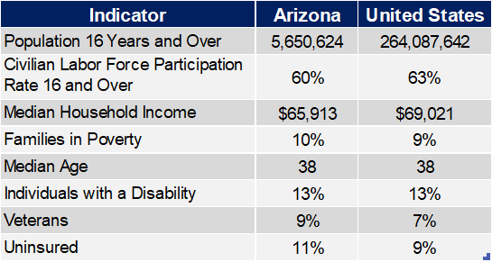
POPULATION CHARACTERISTICS
2021
Source: U.S. Census Bureau, American Community Survey, 2021 5-Year Estimates, Table DP03; Office of Economic Opportunity

Slide 31
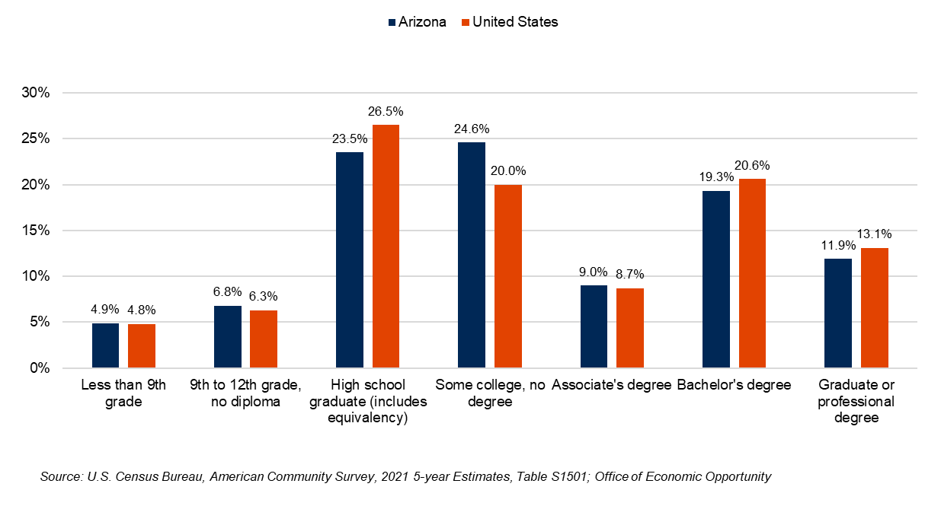
EDUCATIONAL ATTAINMENT
2021 Estimates, Percent of Total Population
Highlights:
In Arizona, the largest percentage of the population has some college, no degree or is a high school graduate (or equivalent)
Nationally, the largest percentage of the population is a high school graduate (or equivalent) or has a bachelor’s degree

Slide 32
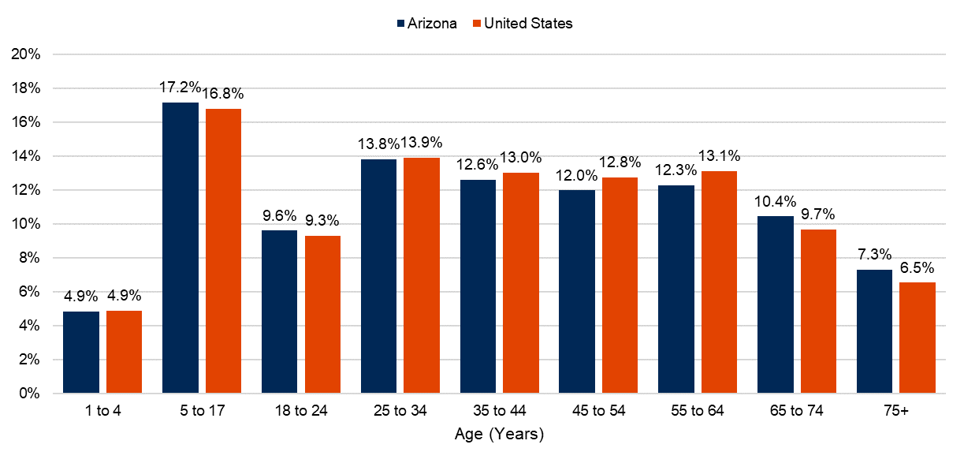
PERCENT OF TOTAL POPULATION BY AGE
2021
Highlights:
Individuals aged 5- to 17-years old make up the largest portion of the population for both Arizona and the Nation
From 2016-2021, Arizona’s population grew by 350,626 individuals (1.0% annually)
Arizona is projected to add more than 487,155 people to its population from 2022-2026 (1.6% annually)
Source: U.S. Census Bureau, American Community Survey, 2021 5-Year Estimates, Table DP03; Office of Economic Opportunity; U.S. Census Bureau

Slide 33
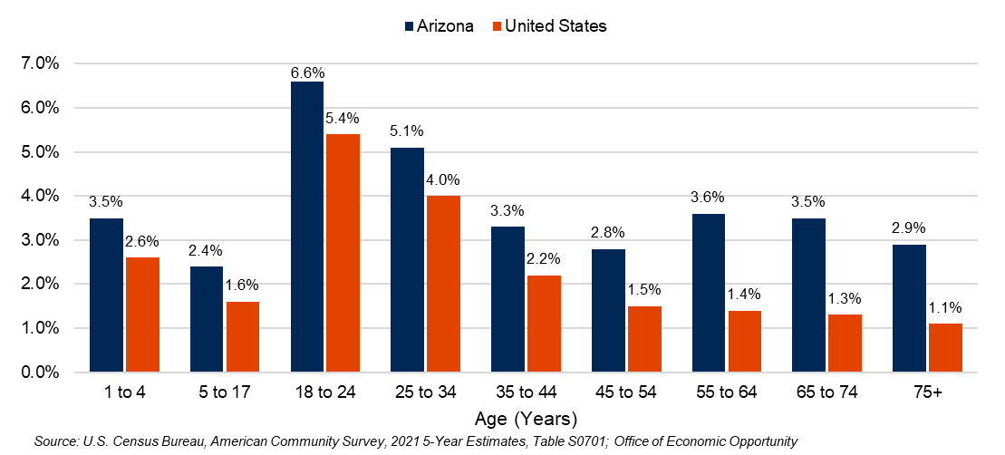
POPULATION CHARACTERISTICS
2021, Moved From Different State
Highlights:
Arizona’s net domestic migration was 89,230 in 2021.
Most of Arizona’s in-migration came from California and Washington
The median age of Arizonans that moved from a different state in 2021 was 33.4, older than the national median age of 28.8
Source: U.S. Census Bureau, American Community Survey, 2021 1-Year Estimates

Slide 34
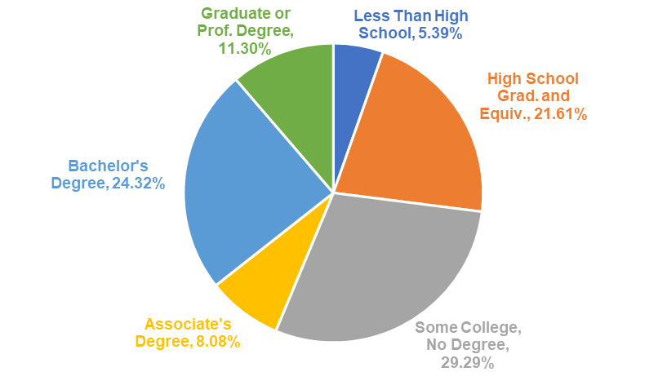
ARIZONA MIGRATION BY EDUCATION LEVEL
2021, Moved From Different State, Age 18-64
Highlights:
Migration by Education:
Graduate or Professional Degree: 7,982 individuals
Bachelor's Degree: 19,931
Associate's Degree: 6,064
Some College, No Degree: 26,509
High School Graduate or Equivalent: 17,729
Less Than High School: 12,015
4.7% of AZ residents aged 25 years and over with a Bachelor’s degree, and 4.5% of individuals with a graduate or professional degree, moved from another state
Source: U.S. Census Bureau, American Community Survey, 2021 5-Year Estimates

Slide 35
ECONOMIC ANALYSIS
In-Demand Industries and Occupations

Slide 36
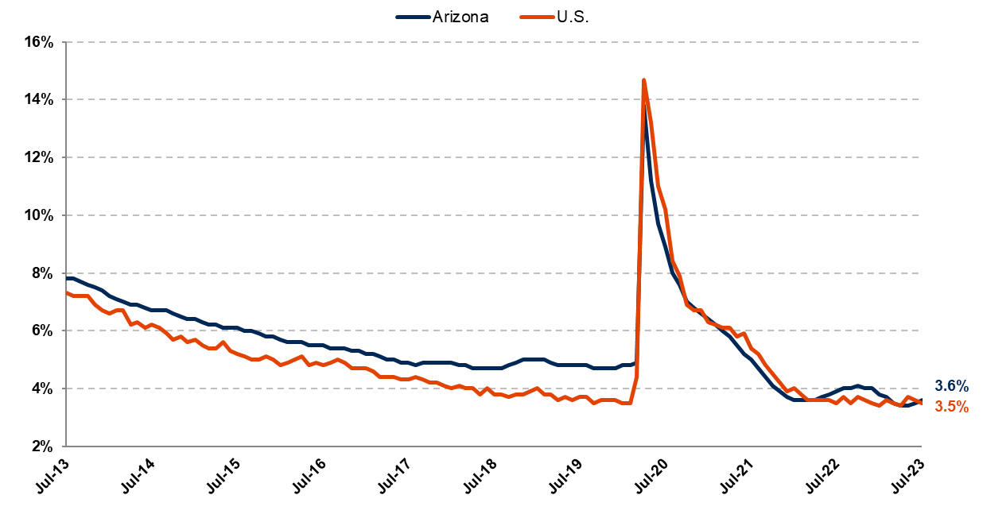
ARIZONA AND U.S. UNEMPLOYMENT
July 2013 – July 2023, Seasonally Adjusted
Source: Produced by the Arizona Office of Economic Opportunity in cooperation with the U.S. Dept. of Labor, BLS
Source: U.S. Census Bureau, American Community Survey, 2021 5-Year Estimates, Table S2301

Slide 37
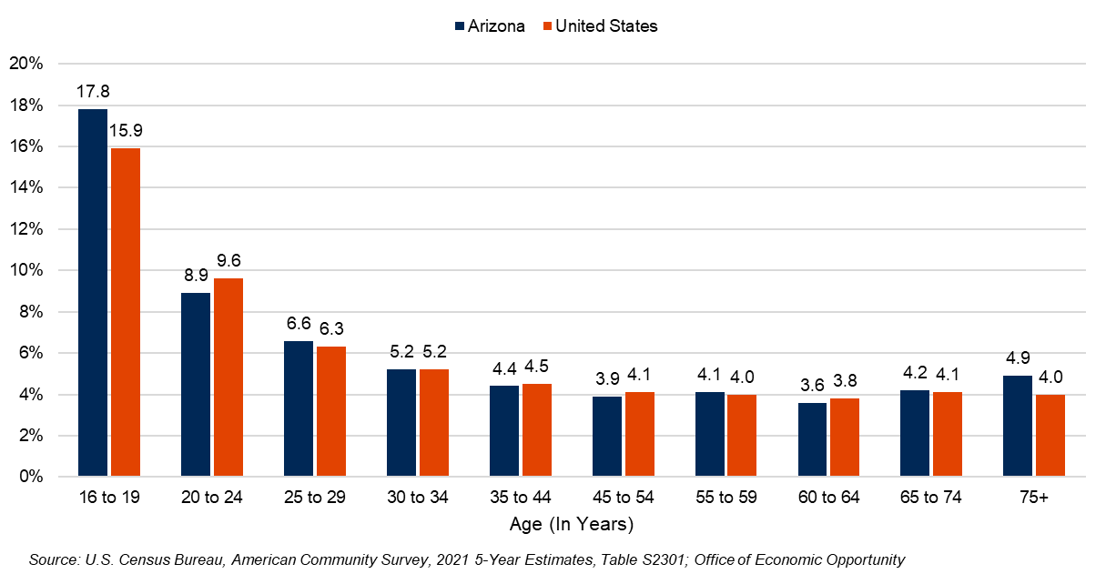
UNEMPLOYMENT RATE BY AGE GROUP
2021, Seasonally Adjusted

Slide 38
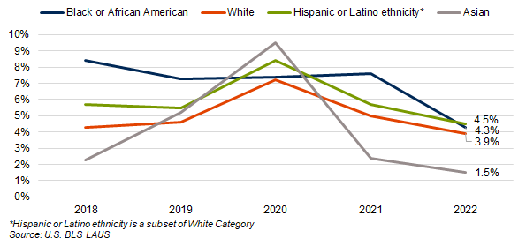
ARIZONA UNEMPLOYMENT RATE BY RACE OR ETHNICITY

Slide 39
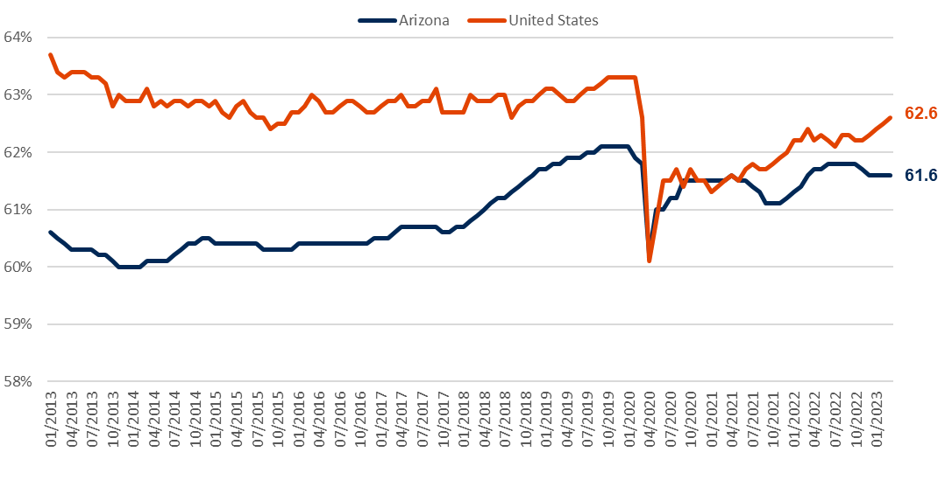
LABOR FORCE PARTICIPATION RATE (LFPR)
Jan. 2013 – March 2023, Seasonally Adjusted
Highlights:
From June 2013 through December 2019, the Arizona LFPR increased by 1.8 percentage points (60.3 to 62.1 percent).
This change equated to an increase of over 411,013 individuals in the labor force (13.4%)
The U.S. labor force grew by 5.7 percent over the same period.
Arizona’s LF hit lowest point in April 2020; fully recovered in October 2020
In March 2023, Arizona’s LF has grown 5.6% from it’s pre-pandemic high (January 2020)
Source: Produced by the Arizona Office of Economic Opportunity in cooperation with the U.S. Dept. of Labor, BLS

Slide 40
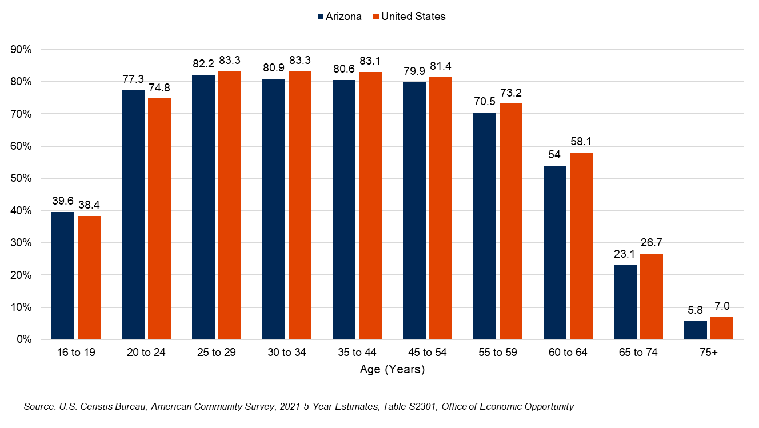
LABOR FORCE PARTICIPATION RATE (LFPR)
2021

Slide 41
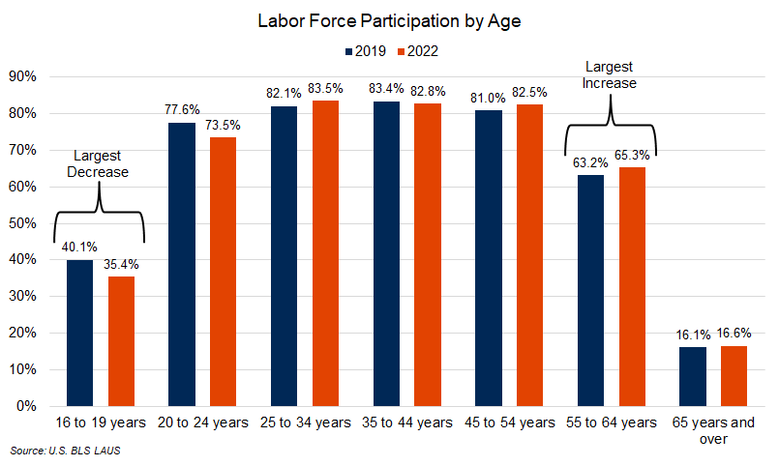
LABOR FORCE PARTICIPATION RATE BY AGE

Slide 42
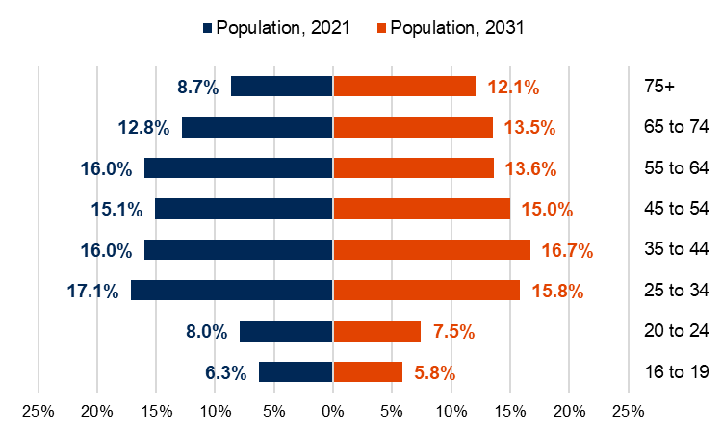
ARIZONA POPULATION PYRAMID
Percent of Total Labor Force
Source: U.S. Census Bureau Population Estimates

Slide 43
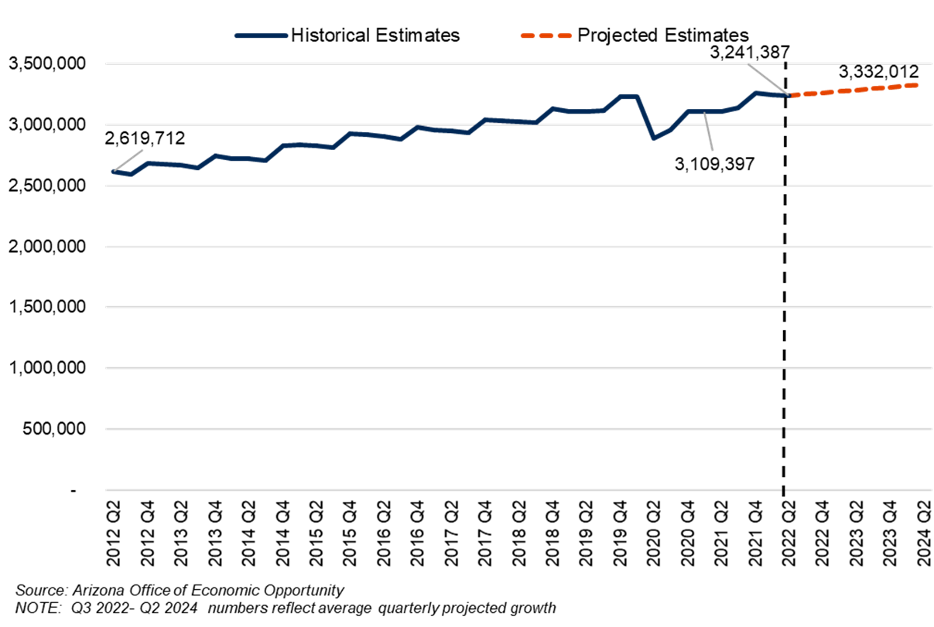
PROJECTED ARIZONA TOTAL EMPLOYMENT
Q2 2022 – Q2 2024, Not Seasonally Adjusted
Highlights:
Total employment is projected to grow by 90,625 jobs, or 1.4% annually, from Q2 2022 to Q2 2024

Slide 44
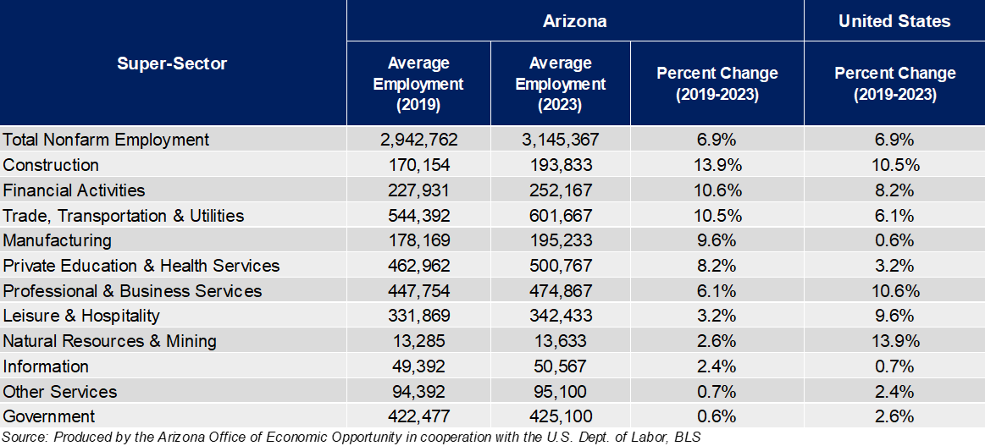
EMPLOYMENT BY SECTOR
Not Seasonally Adjusted

Slide 45
IN-DEMAND INDUSTRY AND OCCUPATION CONSIDERATIONS
SELECTIONS
These are statewide selections, each local area may vary
Seven industries selected as in-demand during the last selection process
All 4- and 5-star occupations within in-demand industries
246 occupations selected
DATA
Uses 2022 as a base year many times
Displays 2022-2024 projections
Council used 2021-2023 data to make in-demand selections as those were the latest projections available at the time
Most recent data can be found at our website
45

Slide 46
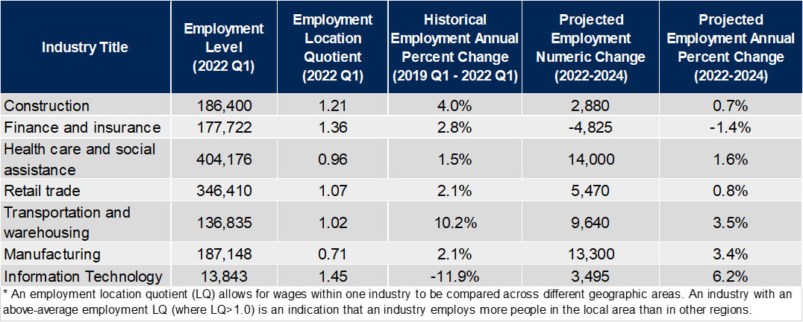
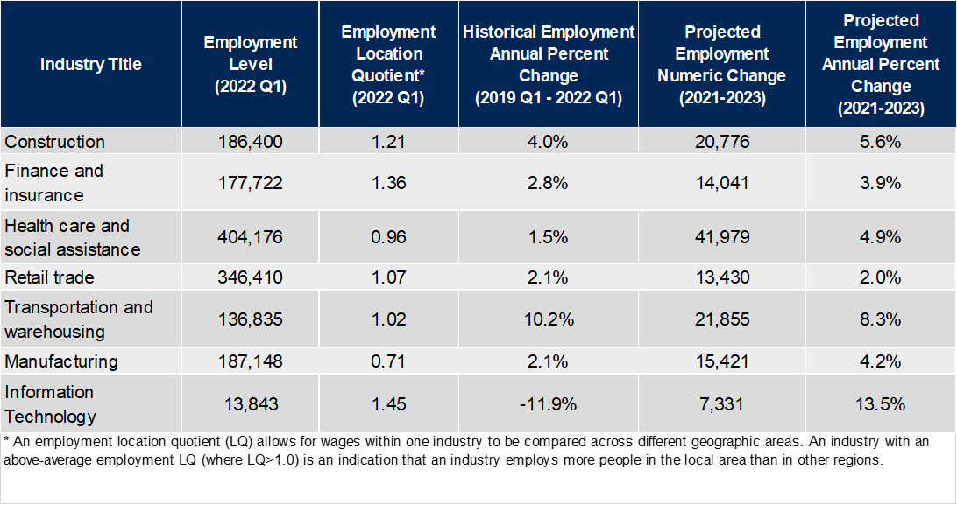
IN-DEMAND INDUSTRIES
Individuals Employed

Slide 47
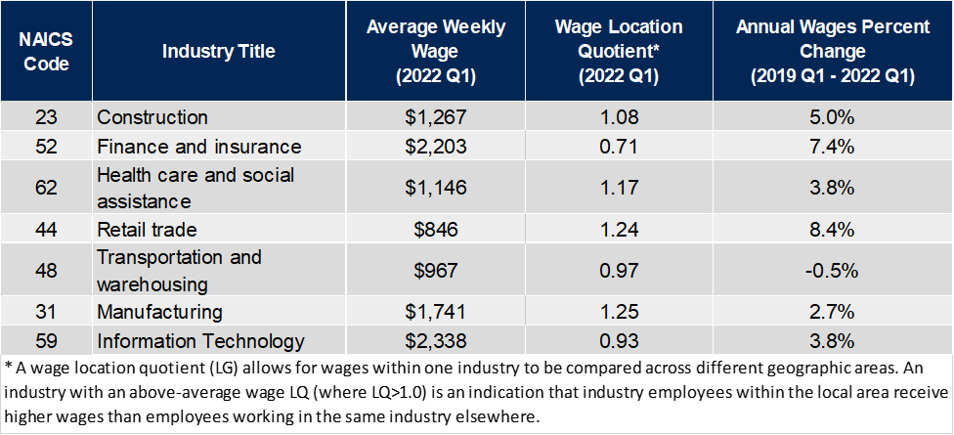
IN-DEMAND INDUSTRIES
Average Wages

Slide 48
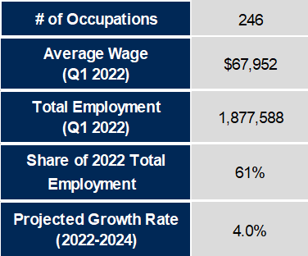
IN-DEMAND OCCUPATIONS
Overview
A breakdown of all occupations can be found on the OEO website
Source: Arizona Office of Economic Opportunity

Slide 49
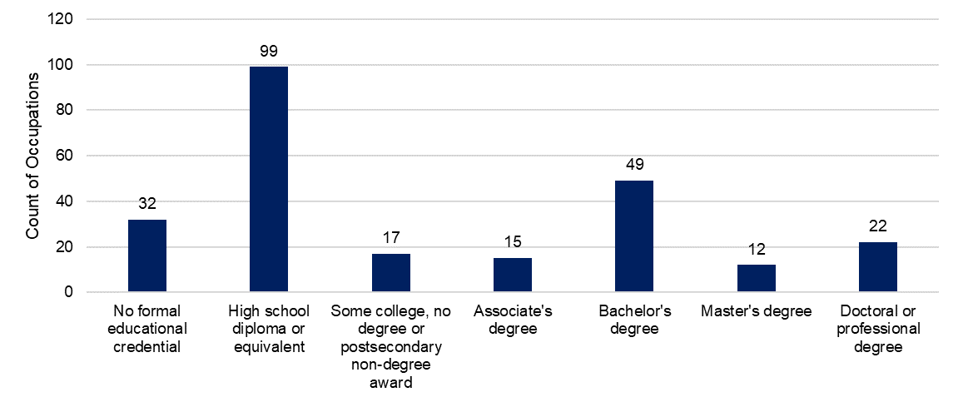
IN-DEMAND OCCUPATIONS
Minimum Educational Requirements
Occupational opportunities available at every education level for WIOA participants.
Source: Office of Economic Opportunity

Slide 50
PERFORMANCE ANALYSIS & NEXT STEPS
WIOA Performance Data, Opportunities for the Workforce System

Slide 51
Increase Enrollment & Completion of Meaningful Training
Highlights:
In general, at least one training was associated with higher employment metrics across the board
More information on WIOA Title I training results can be found HERE
WIOA Training Outcomes: Title I Program Exit Year 2021, Adult, Dislocated, & Youth
WIOA Training Outcomes: Training Programs Utilized for program Exiters between Q1 2018 and Q2 2021
*An in-demand training is a training within an in-demand occupation. Data is based on WIOA program exiters from Q1 2018 and Q2 2021. Source: Office of Economic Opportunity

Slide 52
Increase Enrollment & Completion of Meaningful Training
WIOA Training Outcomes: Title I Program Exit Year 2021, Adult, Dislocated, & Youth
Highlights:
In general, at least one training was associated with higher employment metrics across the board
More information on WIOA Title I training results can be found HERE
Highest Number of Participants:
Transportation and Material Moving (1,066)
Highest Employment Rate, 2nd Quarter After Exit:
Construction and Extraction (82.1%)
Highest Average Wages 2nd Quarter After Exit:
Protective Services ($14,087)
Highest Employment 4th Quarter After Exit:
Construction and Extraction (94.8%)
*An in-demand training is a training within an in-demand occupation. Data is based on WIOA program exiters from Q1 2018 and Q2 2021. Source: Office of Economic Opportunity

Slide 53
Collaborate in Initiatives Across State
Overlap between State Council 2024 Industry Selections, 2020 Local Industry Selections
Create Targeted Programming to Support Specific Objectives
Example: BuilditAZ Apprenticeship Program
53

Slide 54
FINAL REMARKS
Arizona’s population is talented but aging. Arizona is seeing net positive migration to the state at all education levels.
Our unemployment rate has recently trended to be low like many states in the US, but our industry makeup is unique so we may need unique solutions and strategies to help provide ideal job seeker and employer matching.
There are a lot of different mechanisms and tools for Arizona to help our population find employment opportunities and for employers to find talented workers.
For more information on Arizona’s economic and workforce trends, please see the State 4-Year Workforce Plan and/or contact our team for more information.

Slide 55
THANK YOU! Questions? Contact www.laborstats.az.gov labor.info@oeo.az.gov

Slide 56
STATE PLAN UPDATE
Sara Agostinho, DES

Slide 57
State Plan Timeline

Slide 58
DES REORGANIZATION
Anna Hunter, DES

Slide 59
DES Reorganization

Slide 60
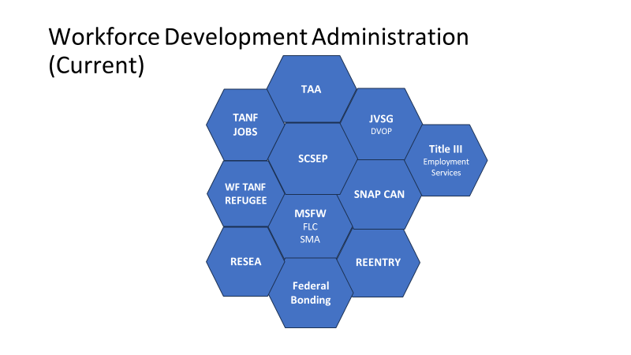
DES Reorganization

Slide 61
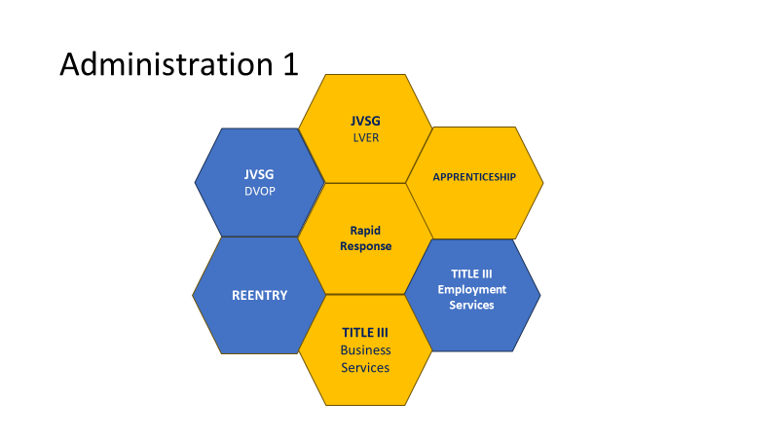
DES Reorganization

Slide 62
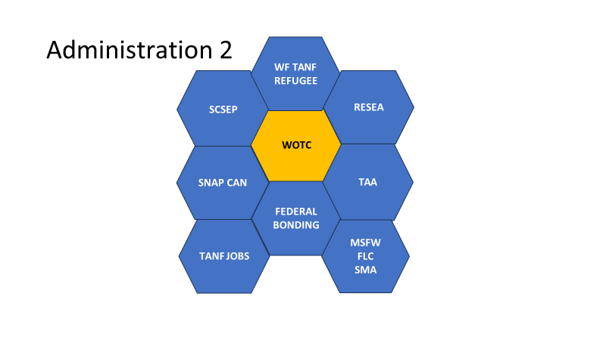
DES Reorganization

Slide 63
DES Reorganization

Slide 64
RAPID RESPONSE UPDATE
Tom Colombo, DES

Slide 65
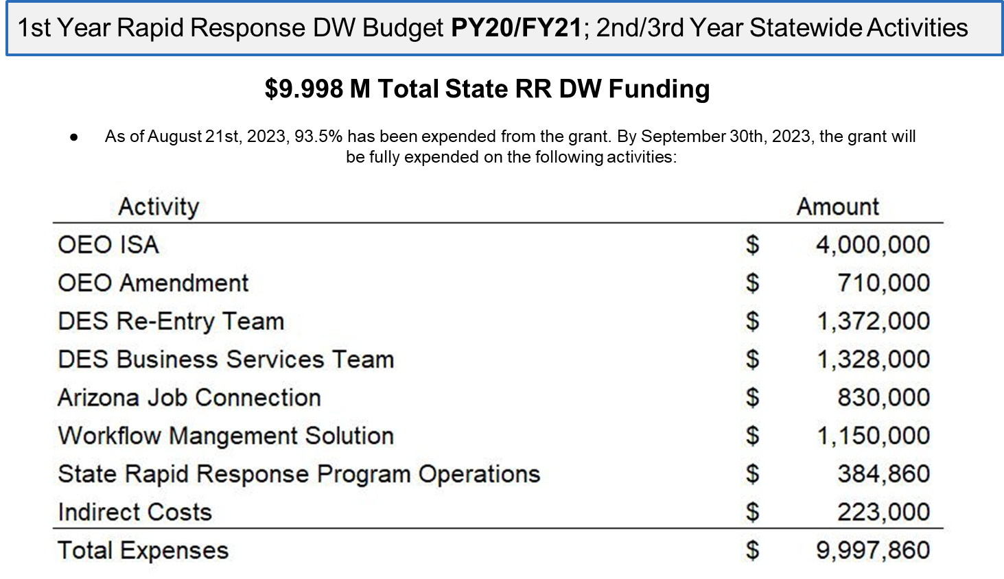

Slide 66
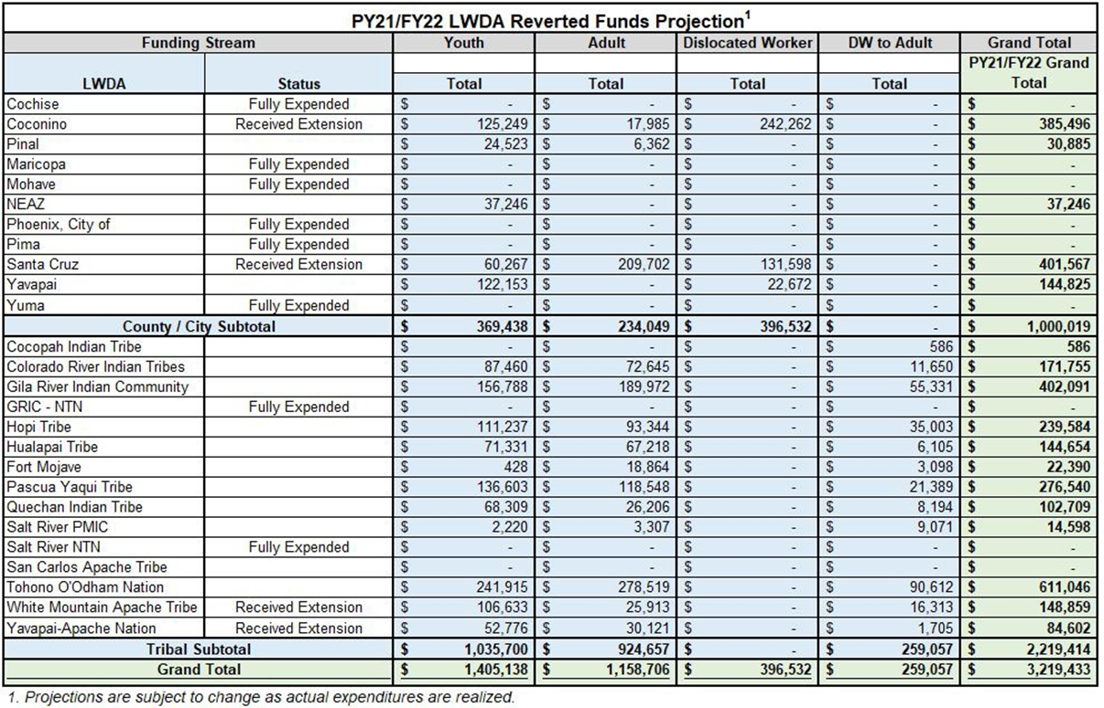

Slide 67
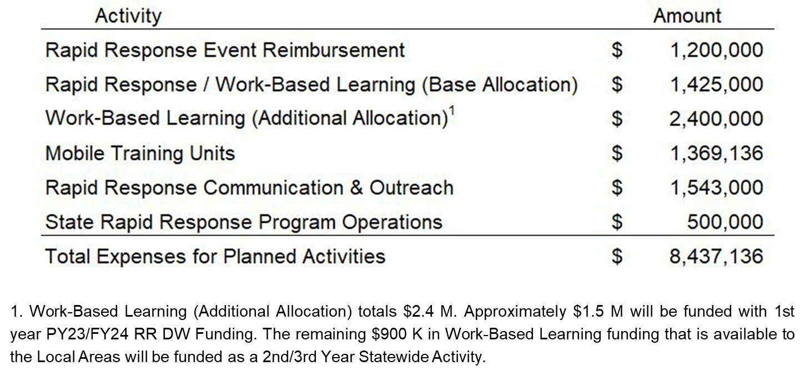

Slide 68
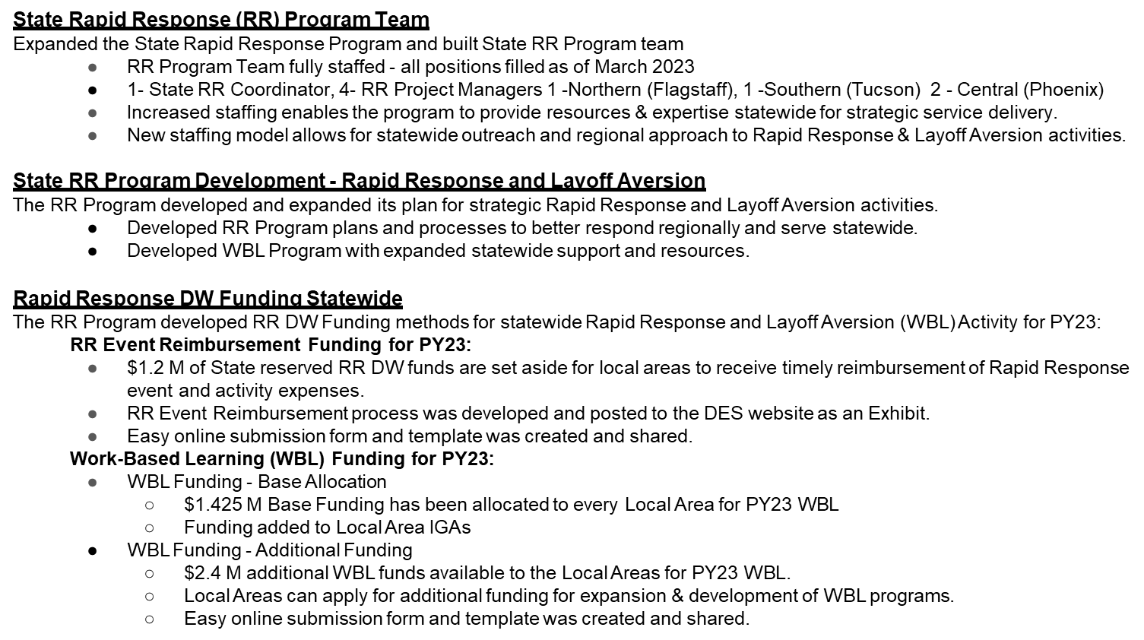

Slide 69
UPCOMING 2024 WORKFORCE ARIZONA COUNCIL DATES
Erin Gallagher, OEO

Slide 70
Workforce Arizona Council 2024 Meeting Dates
Executive Committee
Q1 February 15, 2024
Q2 May 23, 2024
Q3 August 15, 2024
Q4 November 14, 2024
Full Council
Q1 February 22, 2024
Q2 May 30, 2024
Q3 August 22, 2024
Q4 November 21, 2024

Slide 71
WORKFORCE ARIZONA COUNCIL ROUNDTABLE DISCUSSION
Q4 Meeting Focus- Strategic Plan

Slide 72
THANK YOU

